Slide 1

Credit rating
Principal component analysis, k-means clustering, linear interpolation, lowest-coefficients fitting

Slide 2



WHERE WEre WE LAST TIME?
The Model Was Not Sophisticate Enough
K-Means Clustering Algorithm alone cannot answer which groups are good or bad
Issues in Variable Selection
We have to choose the variables ourselves, which might be incomplete and biased. Selected variables might exhibit strong pair-wise correlation, resulting in double effects
Lack of implication of Credit Scoring
We was even not sure at which price a stock should be valued given its credit score

Slide 3
Counter the problems
1
2
3
4
5
Inter-quartile Range Method
Principal Component Analysis
K-Means Clustering Algorithm
Linear Interpolation
Lowest-Coefficients Regression
Data Standardization
Variable Selection
Grouping
Scoring
Pricing

Slide 4
Counter the problems
1
2
3
4
5
Inter-quartile Range Method
Principal Component Analysis
K-Means Clustering Algorithm
Linear Interpolation
Lowest-Coefficients Regression
Data Standardization
Variable Selection
Grouping
Scoring
Pricing

Slide 5
Data Standardization Inter-quartile Range Method (IQR)
-1
0
1
mean value

Slide 6
Counter the problems
1
2
3
4
5
Inter-quartile Range Method
Principal Component Analysis
K-Means Clustering Algorithm
Linear Interpolation
Lowest-Coefficients Regression
Data Standardization
Variable Selection
Grouping
Scoring
Pricing

Slide 7

Variable selection Principal Component Analysis (PCA)
Remove correlation between variables, avoid double effect
Change of basis is a linear transformation, which preserves distance between data points

Slide 8
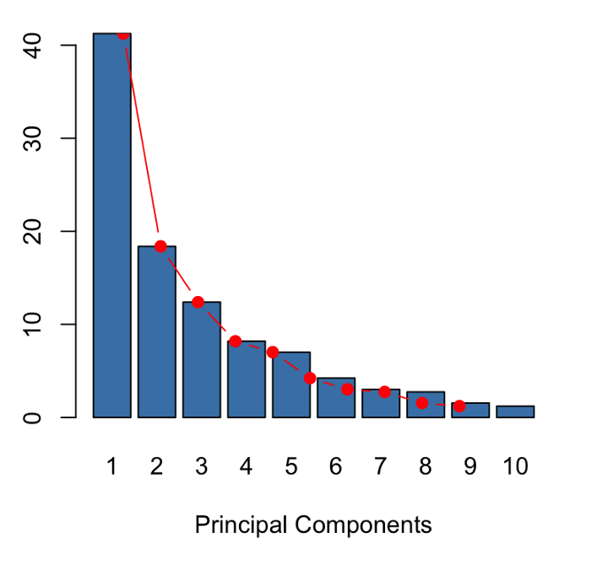
Variable selection Principal Component Analysis (PCA)
We can thrown a bunch of variables into the model. The model can produce a set of much fewer variables, called principal components (which are completely uncorrelated) that describes most of the input variables
Explained Percentage
PCA extracts the most important information from that pool of variables
We do not have to choose the variables ourselves
The more variables thrown into the model, the more confidence we have that we capture “all” financial aspect of a companies

Slide 9
Variable selection – General industry Principal Component Analysis (PCA)
Altman Z-score: (5 variables)
Working Capital / Total Assets
Retained Earnings / Total Assets
EBIT/ Total Assets
Equity / Total Liabilities
Sales / Total Assets
Fulmer H-score: (9 variables)
Retained Earnings / Total Assets
Revenue / Total Assets
EBIT / Equity
OCF / Debt
Debt / Equity
Current Liabilities / Total Assets
log(Tangible Assets)
Working Cap / Debt
EBIT / Interest Expense
Fiin Group Key Indicators (17 variables)
Return on Capital Employed (ROCE)
Account Receivables Turnover
Inventories Turnover
Payable Turnover
Asset Turnover
Equity Turnover
Cash Ratio
Quick Ratio
Current Ratio
Long-term Debt / Equity
Long-term Debt / Total Assets
Debt / Equity
Debt / Total Assets
Short-term Debt / Equity
Short-term Debt / Total Assets
Liabilities / Equity
Liabilities / Total Assets
Beneish M-score: (8 variables)
Days Sales in Receivables Index
Gross Margin Index
Asset Quality Index
Sales Growth Index
Depreciation Index
SG&A Expenses Index
Leverage Index
Total Accruals to Total Assets
I don’t care, take ׳em all
Many more from online research papers…

Slide 10
Variable selection Principal Component Analysis (PCA)
General Industries:
44 variables
Banking:
37 variables
Reduced to a half number of PCs
Insunrance:
29 variables
Brokerage:
25 variables

Slide 11
Counter the problems
1
2
3
4
5
Inter-quartile Range Method
Principal Component Analysis
K-Means Clustering Algorithm
Linear Interpolation
Lowest-Coefficients Regression
Data Standardization
Variable Selection
Grouping
Scoring
Pricing

Slide 12
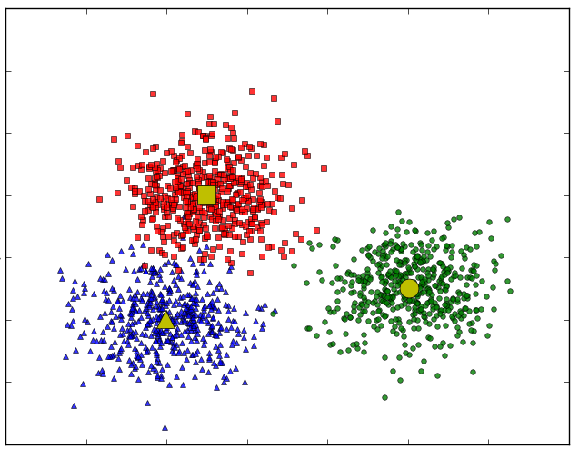
Grouping K-Means Clustering Algorithm
Example in 2D space
1
K-Means facilitates grouping (or classifying) data points in multi-dimensional space
Each group is represented by a centroid (center of that group)
PC2
Each data point represents a company
-1
-1
PC1
1

Slide 13
Counter the problems
1
2
3
4
5
Inter-quartile Range Method
Principal Component Analysis
K-Means Clustering Algorithm
Linear Interpolation
Lowest-Coefficients Regression
Data Standardization
Variable Selection
Grouping
Scoring
Pricing

Slide 14
Scoring Linear Interpolation
1
We assign credit scores to every points on the boundary curves:
Boundary curve 1: 25
Boundary curve 2: 50
Boundary curve 3: 75
×
×
82
97
×
×
Centroid 3
67
73
Centroid 2
×
×
×
48
52
70
×
45
Boundary Curve 3
Linear Interpolation is used to compute the credit score of any company lies between 2 boundary curves
×
×
×
18
28
37
×
Centroid 1
22
×
24
×
×
31
14
-1
-1
Boundary Curve 1
Boundary Curve 2
1

Slide 15
Counter the problems
1
2
3
4
5
Inter-quartile Range Method
Principal Component Analysis
K-Means Clustering Algorithm
Linear Interpolation
Lowest-Coefficients Regression
Data Standardization
Variable Selection
Grouping
Scoring
Pricing

Slide 16
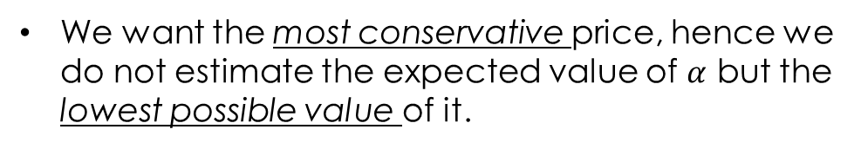


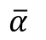
Pricing Lowest Possible Coefficients Regression
Price
By conservatively assuming liquidation value = 0, we implies that every stock whose credit score = 0 is worthless, hence its price must be 0
Then we estimate the model: ${Fair Price}_{t+1}= α. {Score}_{t}$
We want the most conservative price, hence we do not estimate the expected value of $α$ but the lowest possible value of it.
$$α_{lowest}$$
$$\overline{α}$$
Liq
95% confidence interval
0
Score

Slide 17

MODEL'S RESULT

Slide 18
HOSE: MWG Mobile World Investment Corporation

Slide 19
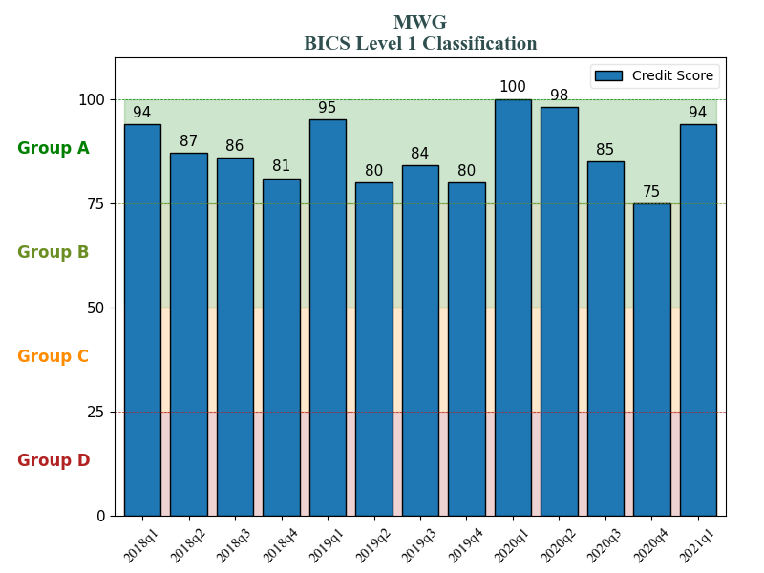
general industries HOSE: MWG - Mobile World Investment Corporation
general industries HOSE: MWG - Mobile World Investment Corporation

Slide 20
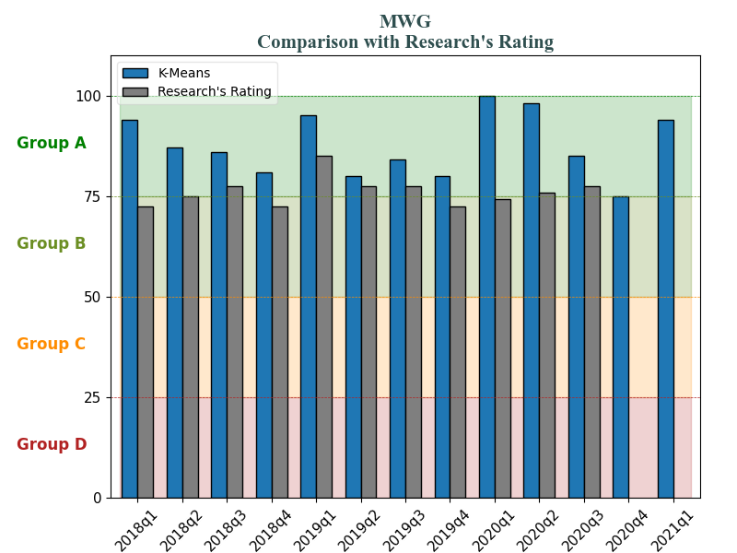
general industries HOSE: MWG - Mobile World Investment Corporation
general industries HOSE: MWG - Mobile World Investment Corporation

Slide 21
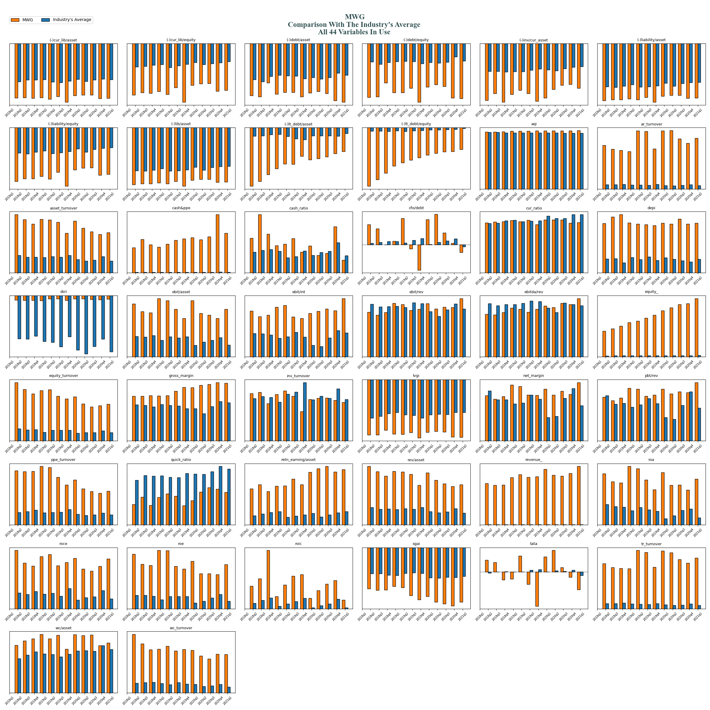
general industries HOSE: MWG - Mobile World Investment Corporation

Slide 22
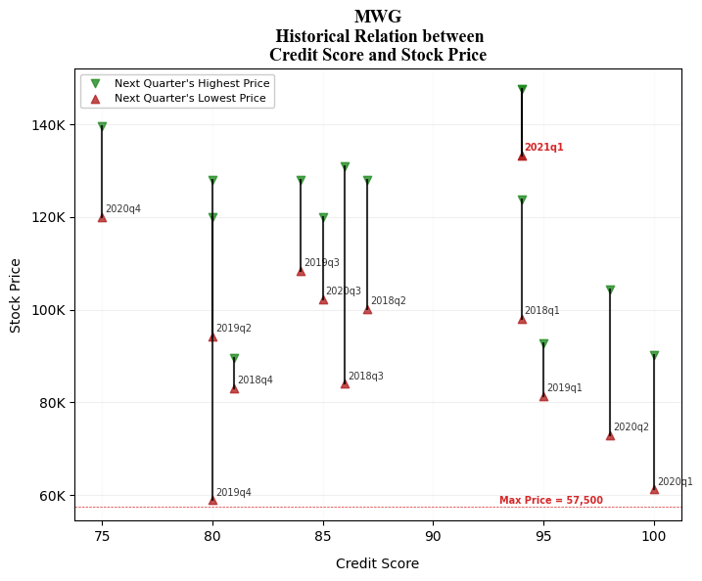
general industries HOSE: MWG - Mobile World Investment Corporation

Slide 23
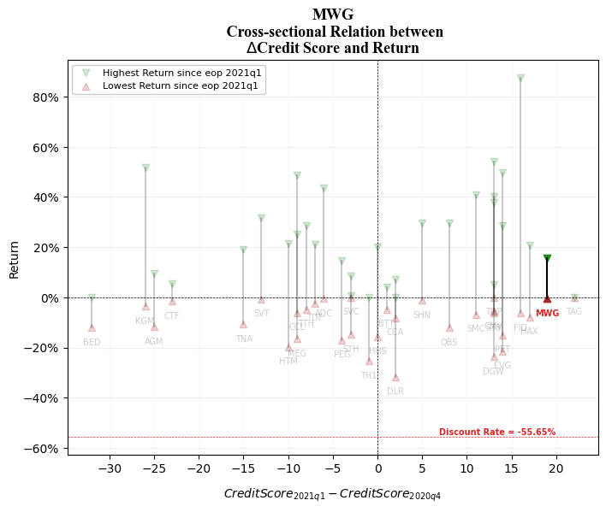
general industries HOSE: MWG - Mobile World Investment Corporation

Slide 24
HOSE: VNM Viet Nam Dairy Products Joint Stock Company

Slide 25
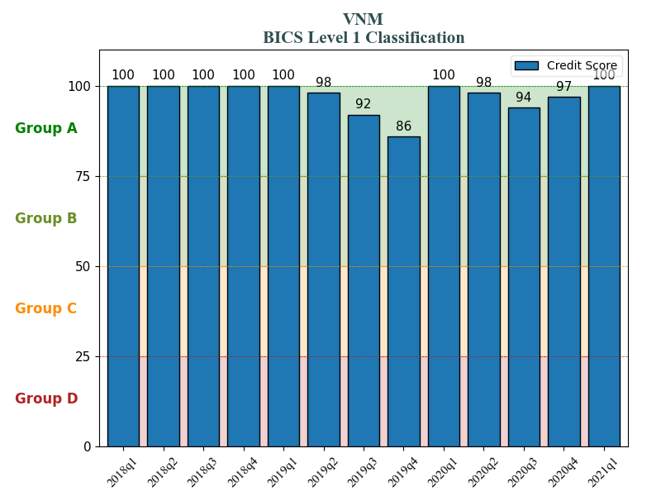
general industries HOSE: MWG - Mobile World Investment Corporation
general industries HOSE: VNM - Viet Nam Dairy Products Joint Stock Company

Slide 26
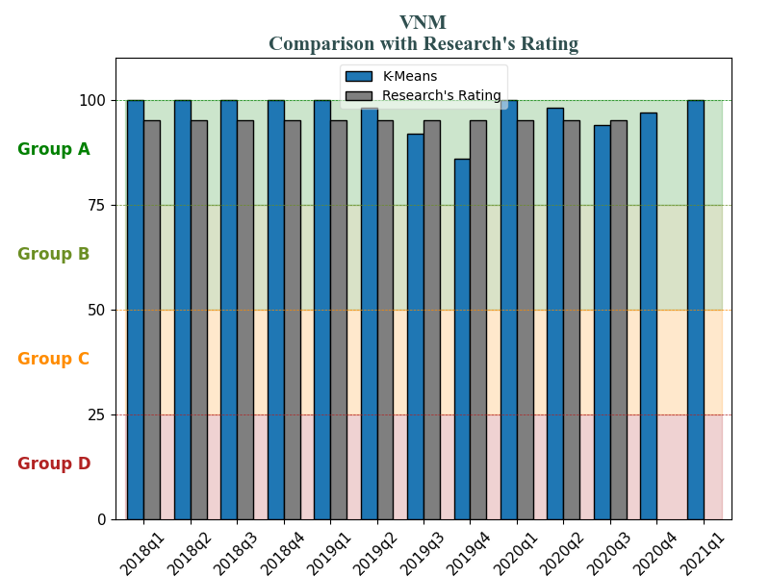
general industries HOSE: MWG - Mobile World Investment Corporation
general industries HOSE: VNM - Viet Nam Dairy Products Joint Stock Company

Slide 27
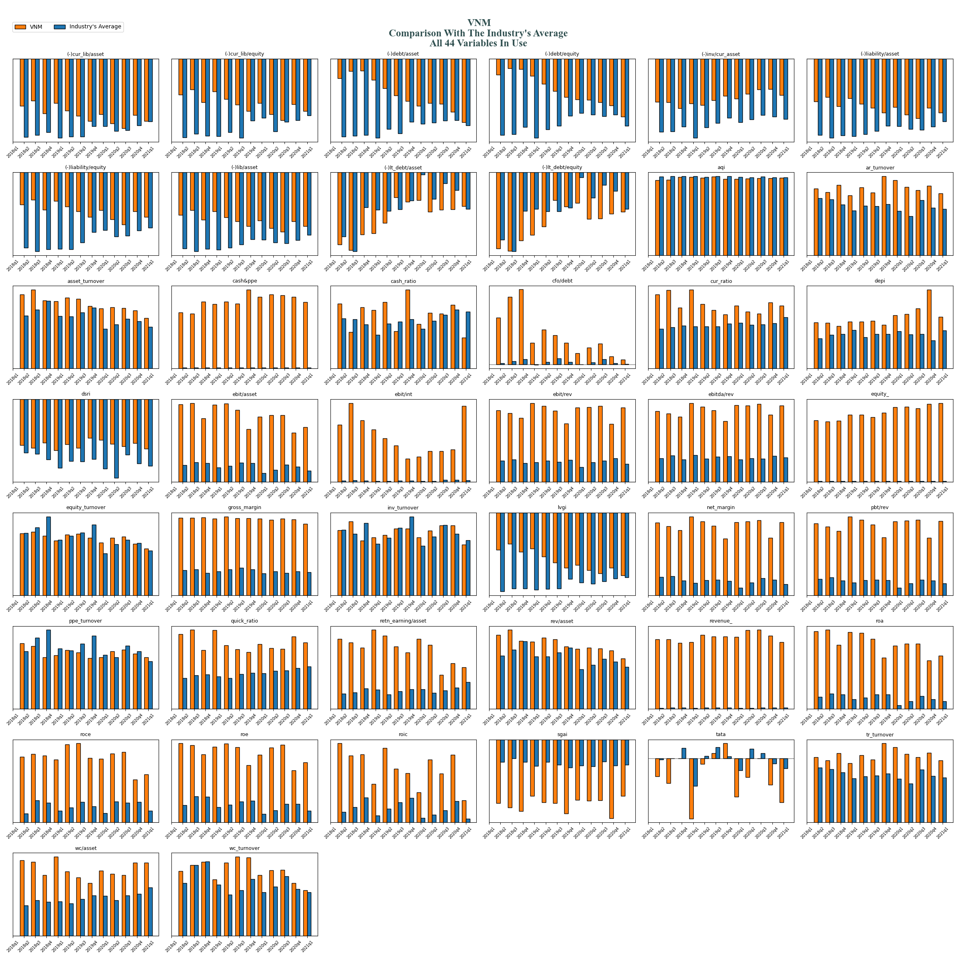
general industries HOSE: VNM - Viet Nam Dairy Products Joint Stock Company

Slide 28
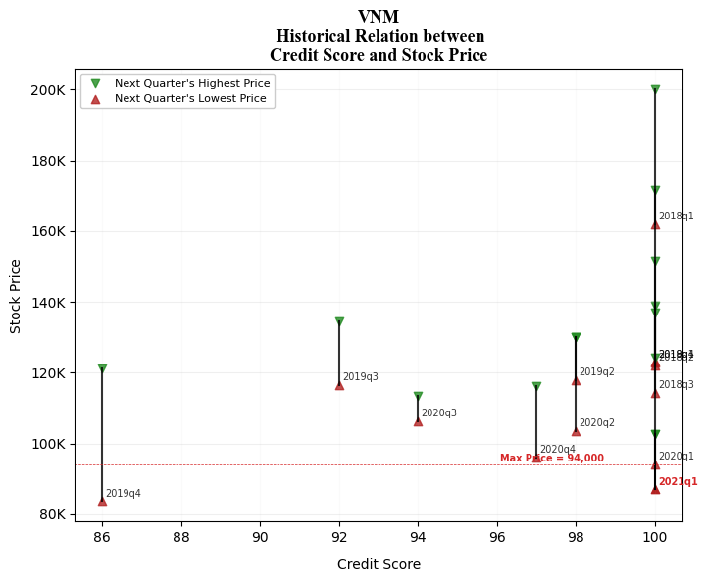
general industries HOSE: VNM - Viet Nam Dairy Products Joint Stock Company

Slide 29
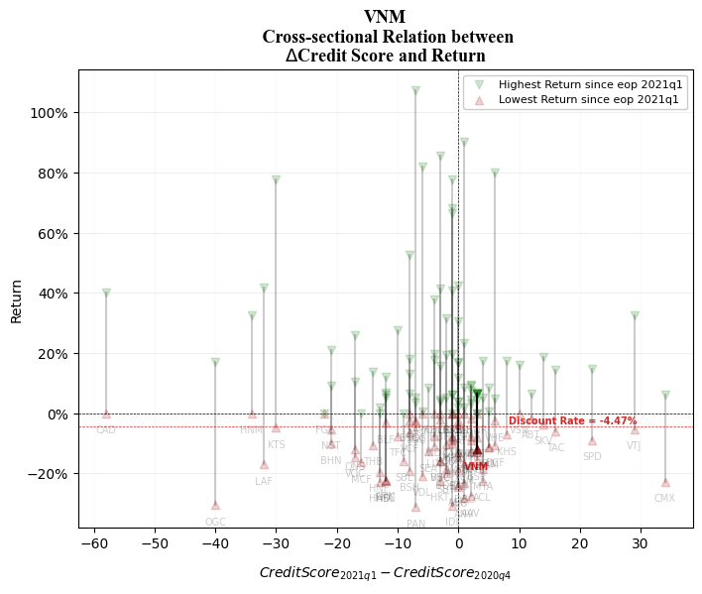
general industries HOSE: VNM - Viet Nam Dairy Products Joint Stock Company

Slide 30
HOSE: HSG Hoa Sen Group

Slide 31
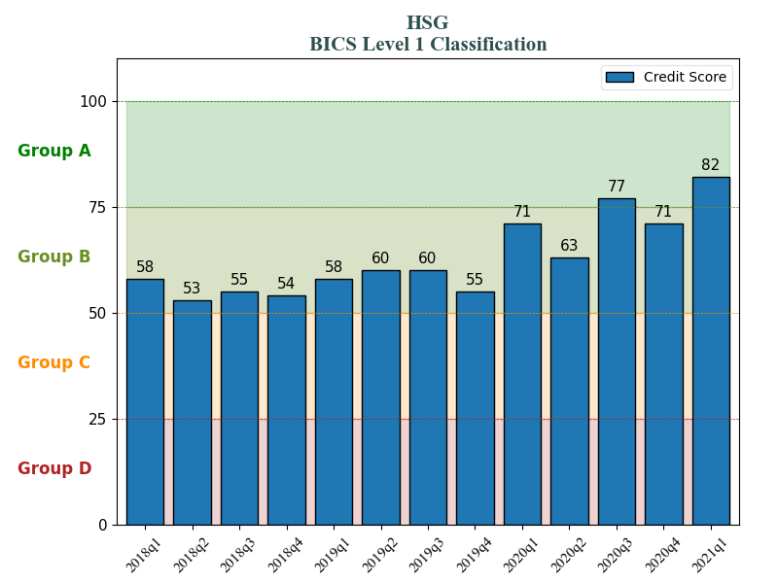
general industries HOSE: MWG - Mobile World Investment Corporation
general industries HOSE: HSG - HOA Sen group

Slide 32
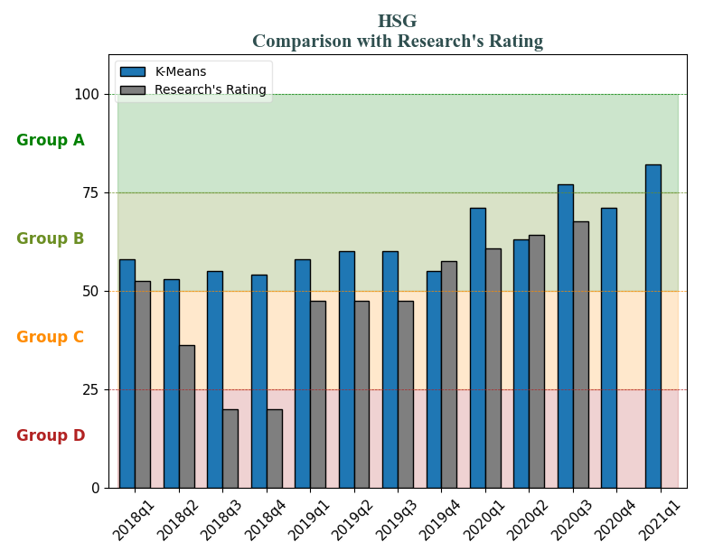
general industries HOSE: MWG - Mobile World Investment Corporation
general industries HOSE: HSG - HOA Sen group

Slide 33
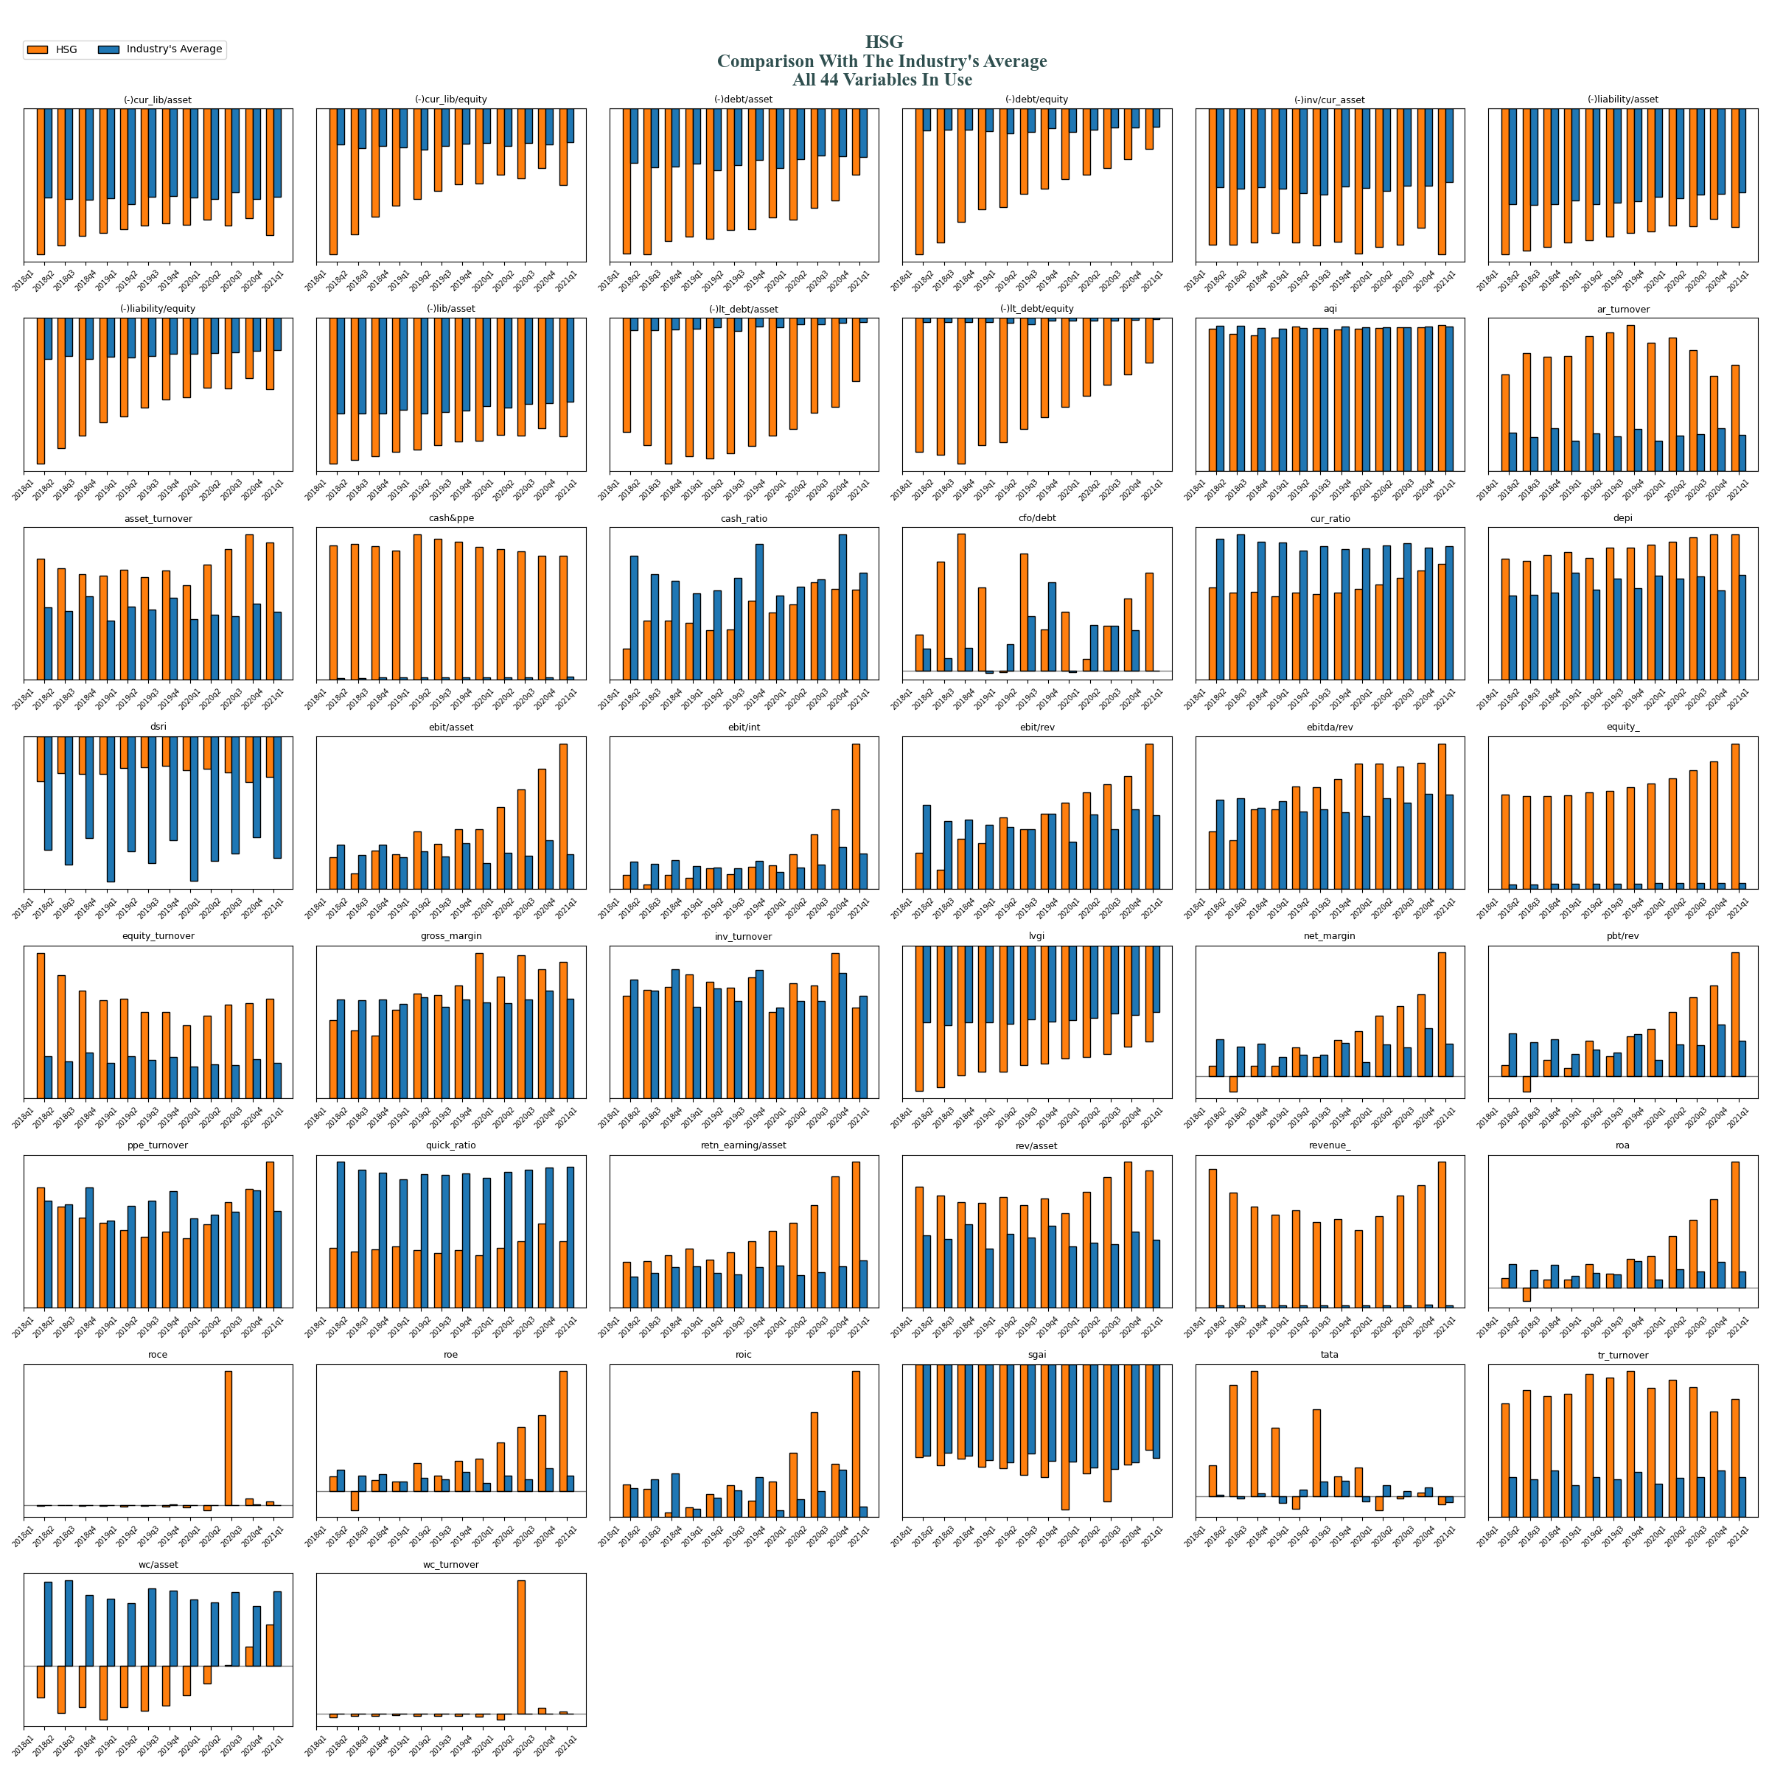
general industries HOSE: HSG - HOA Sen group

Slide 34
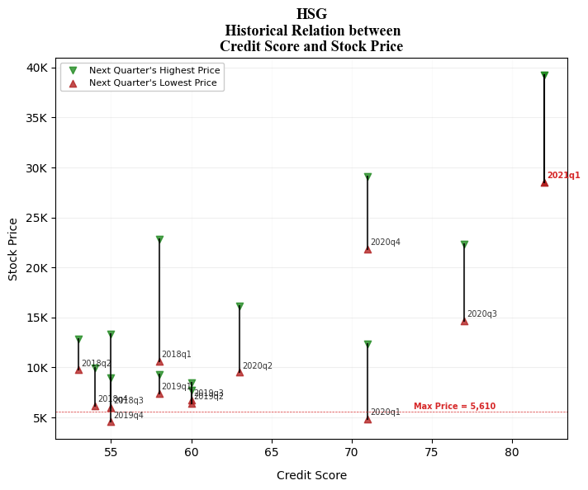
general industries HOSE: HSG - HOA Sen group

Slide 35
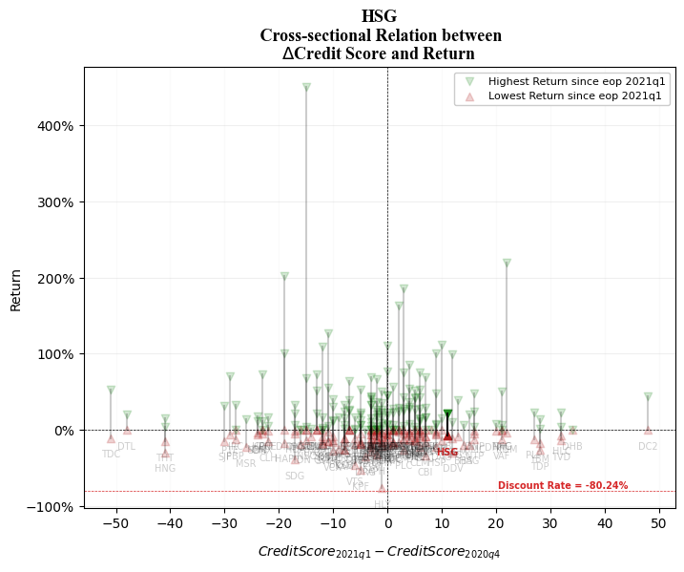
general industries HOSE: HSG - HOA Sen group

Slide 36
HOSE: FLC FLC Group JSC

Slide 37
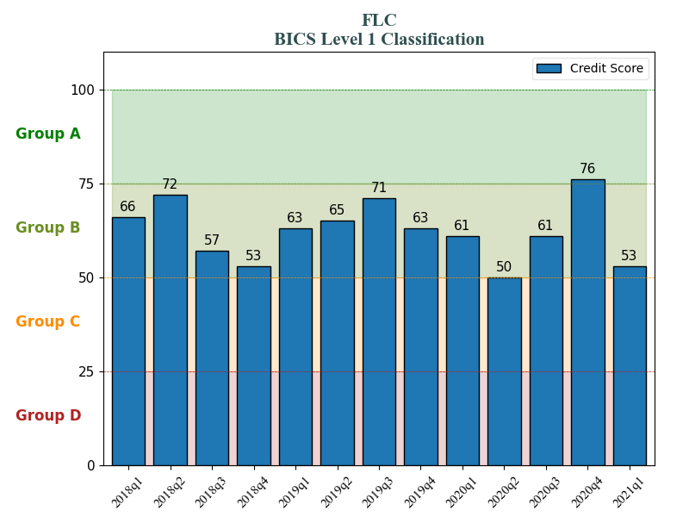
general industries HOSE: MWG - Mobile World Investment Corporation
general industries HOSE: FLC - FLC Group JSC

Slide 38
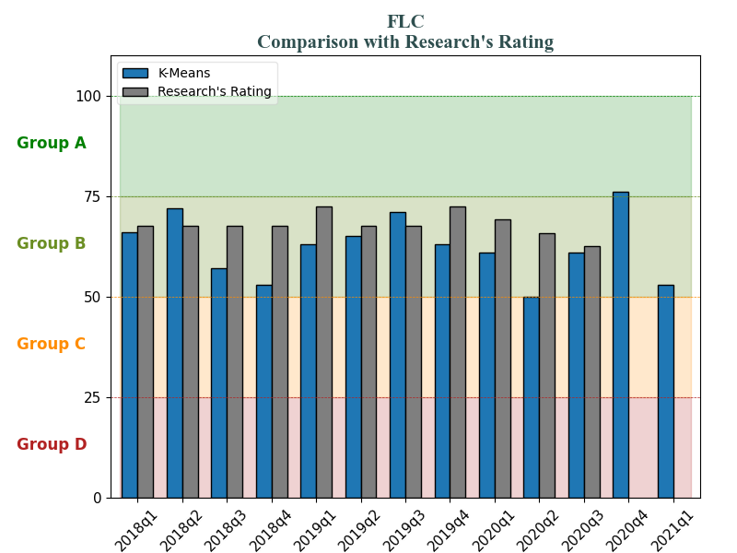
general industries HOSE: MWG - Mobile World Investment Corporation
general industries HOSE: FLC - FLC Group JSC

Slide 39
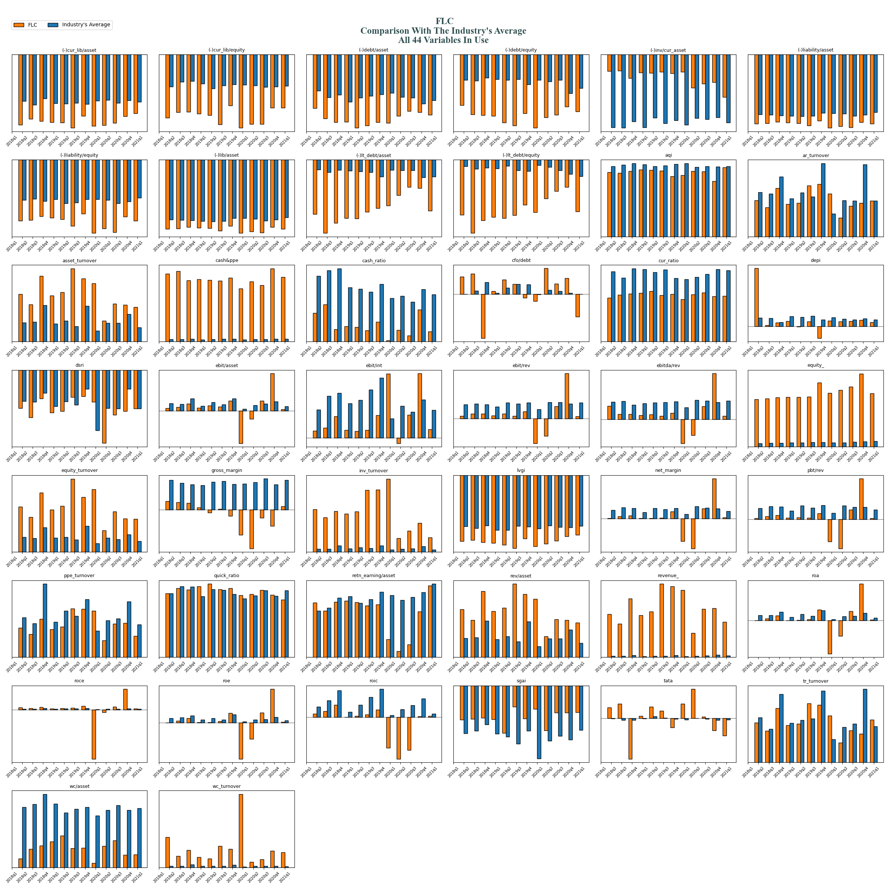
general industries HOSE: FLC - FLC Group JSC

Slide 40
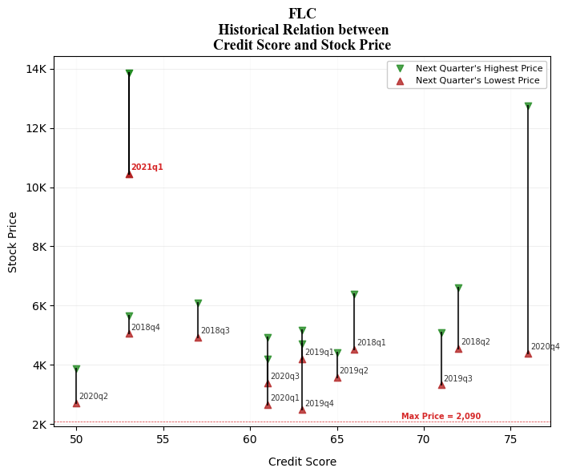
general industries HOSE: FLC - FLC Group JSC

Slide 41
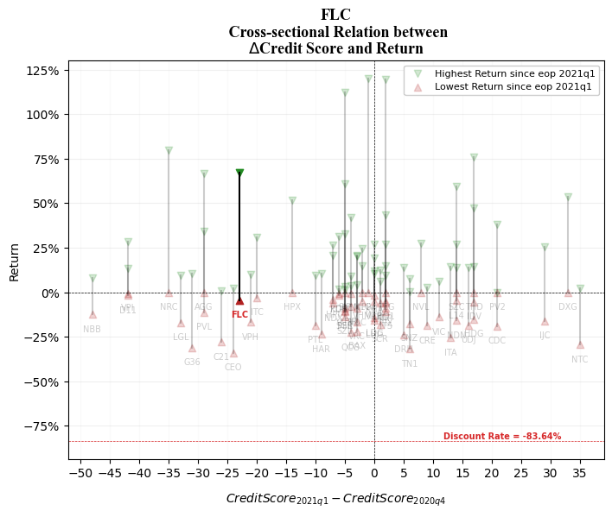
general industries HOSE: FLC - FLC Group JSC

Slide 42
HOSE: VJC Vietjet Aviation Joint Stock Company

Slide 43
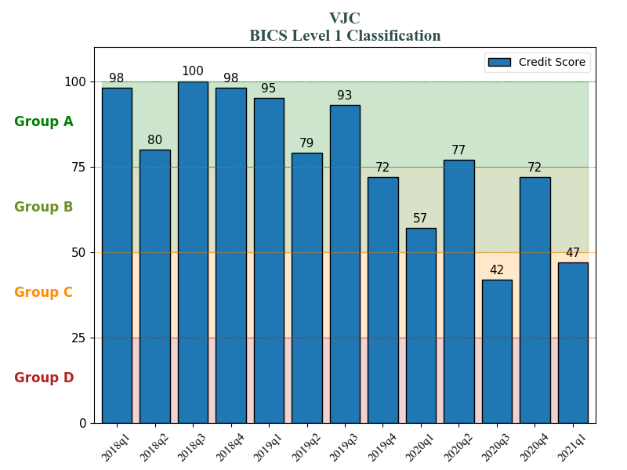
general industries HOSE: MWG - Mobile World Investment Corporation
general industries HOSE: VJC - Vietjet Aviation Joint Stock Company

Slide 44
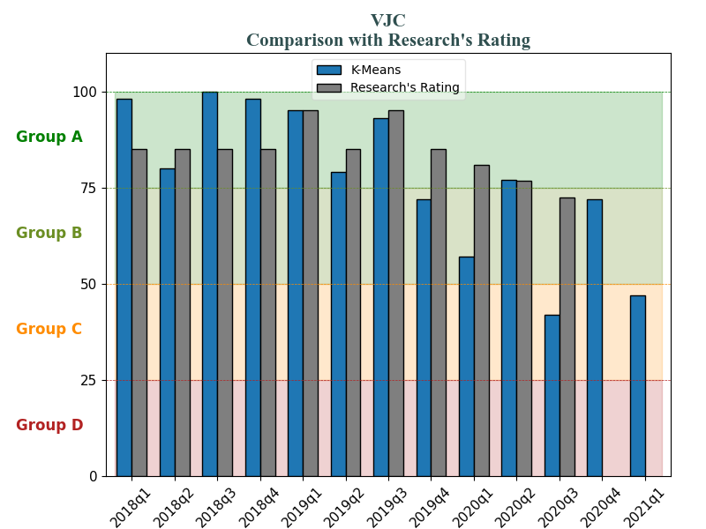
general industries HOSE: MWG - Mobile World Investment Corporation
general industries HOSE: VJC - Vietjet Aviation Joint Stock Company

Slide 45
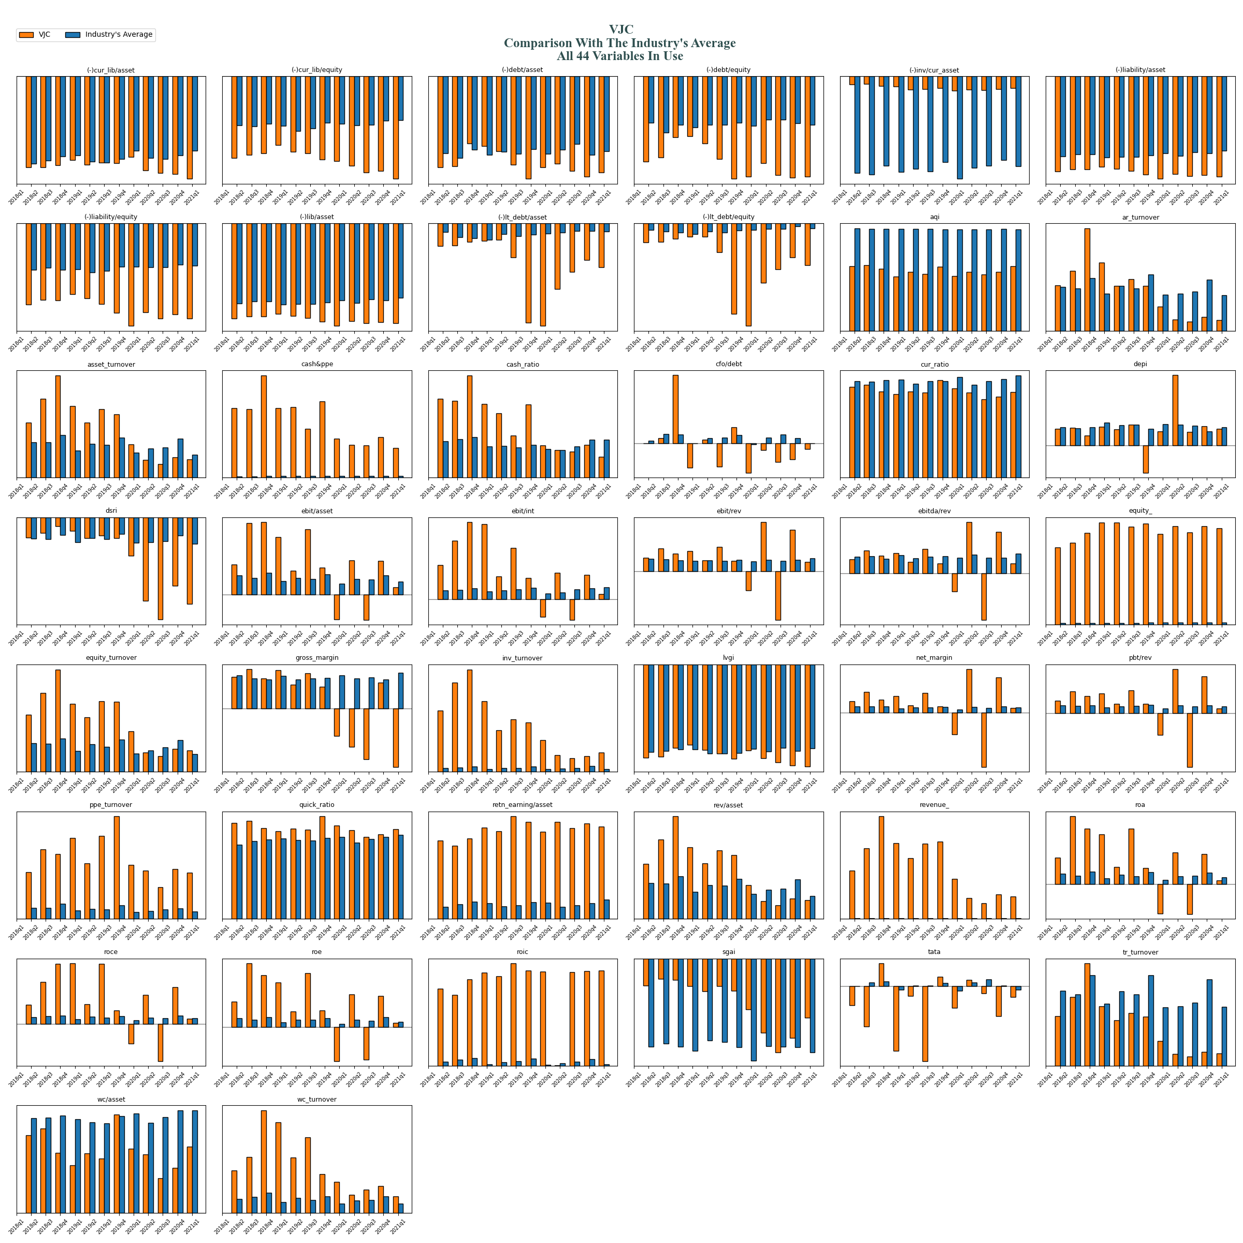
general industries HOSE: VJC - Vietjet Aviation Joint Stock Company

Slide 46
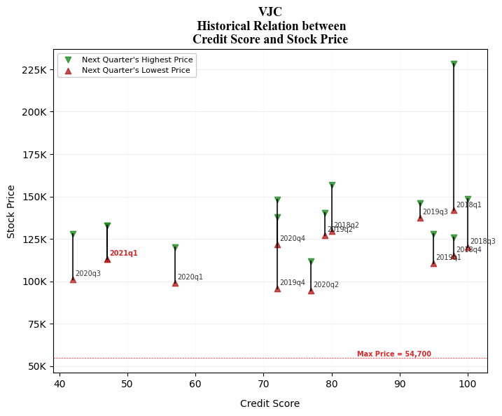
general industries HOSE: VJC - Vietjet Aviation Joint Stock Company

Slide 47
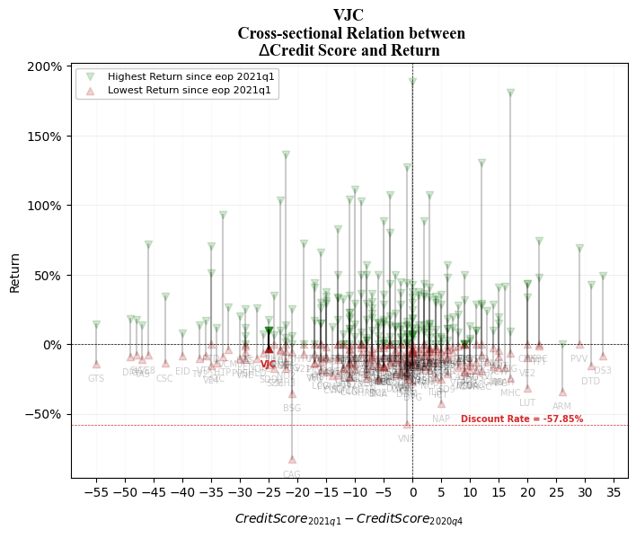
general industries HOSE: VJC - Vietjet Aviation Joint Stock Company

Slide 48
HOSE: FPT FPT Corporation

Slide 49
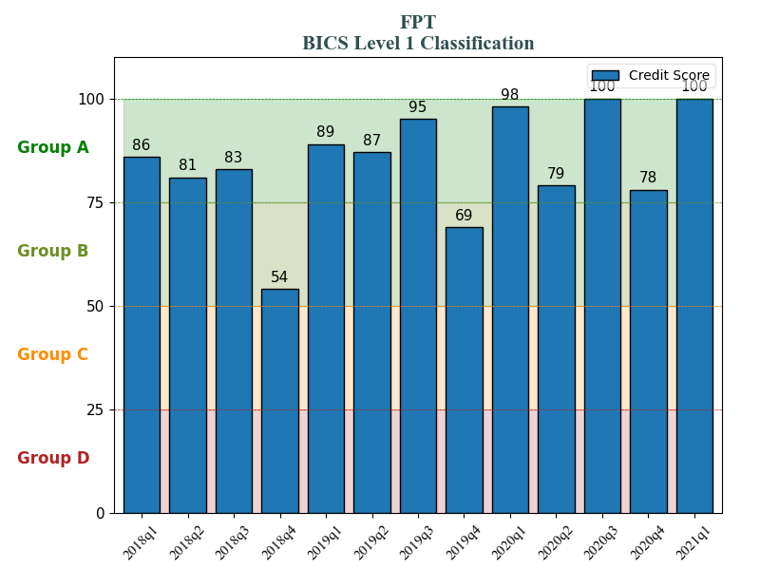
general industries HOSE: MWG - Mobile World Investment Corporation
general industries HOSE: FPT - FPT Corporation

Slide 50
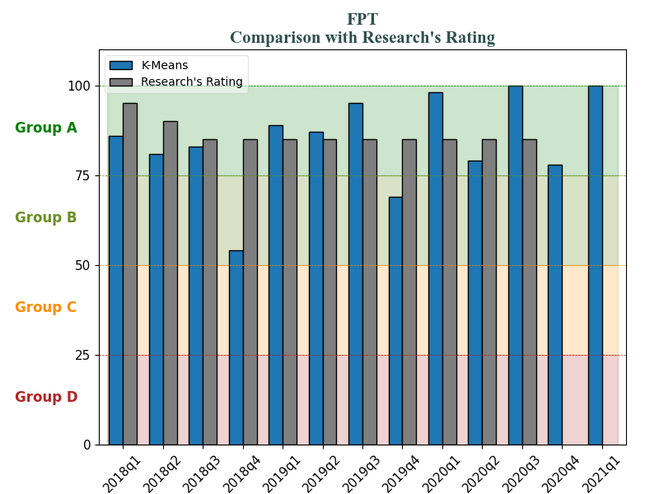
general industries HOSE: MWG - Mobile World Investment Corporation
general industries HOSE: FPT - FPT Corporation

Slide 51
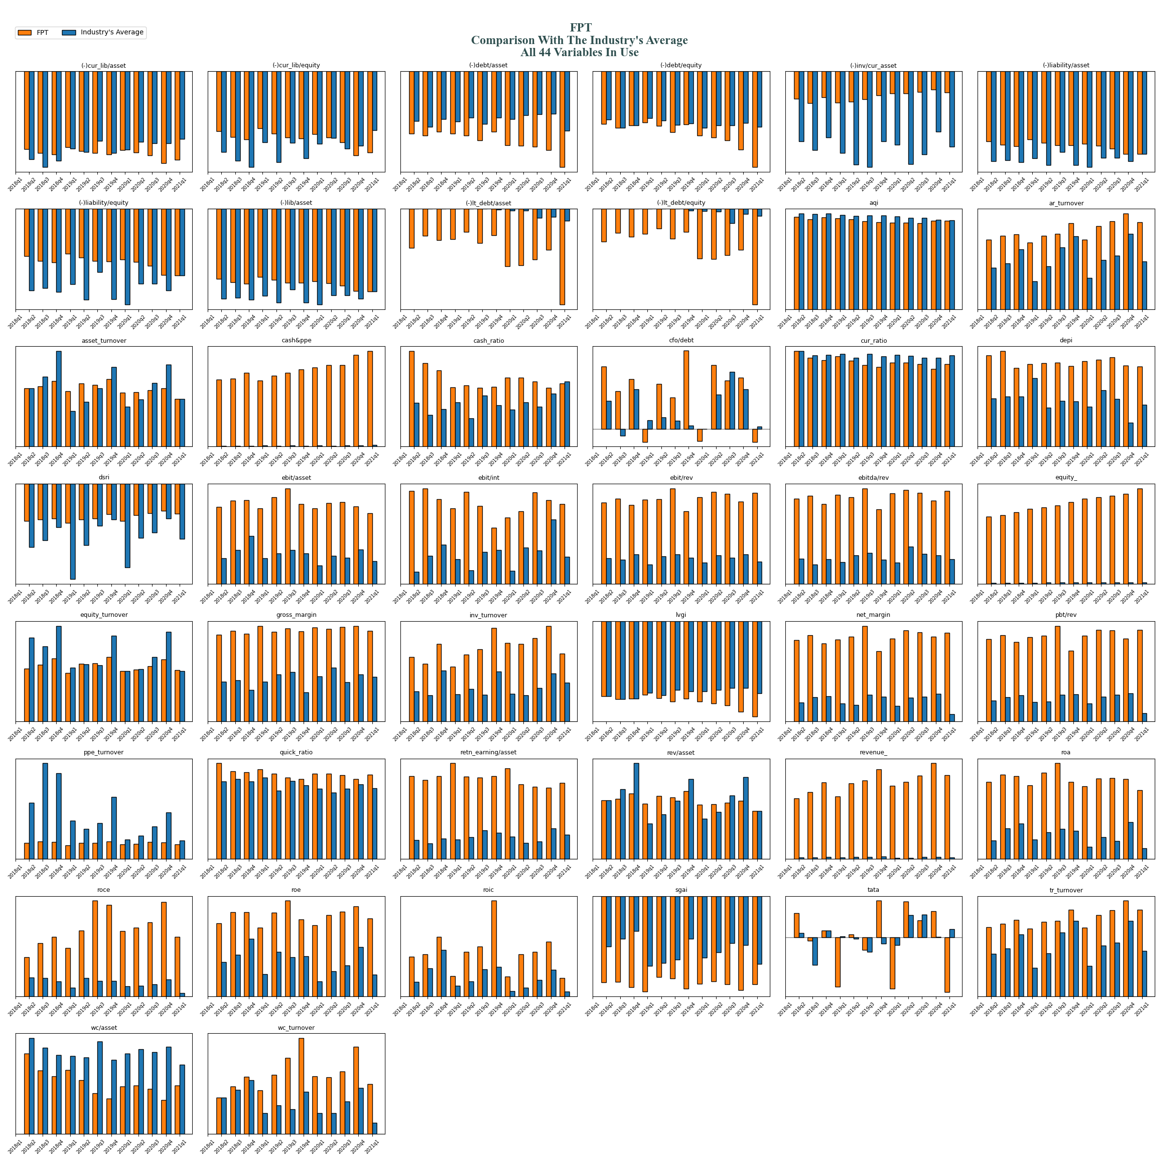
general industries HOSE: FPT - FPT Corporation

Slide 52
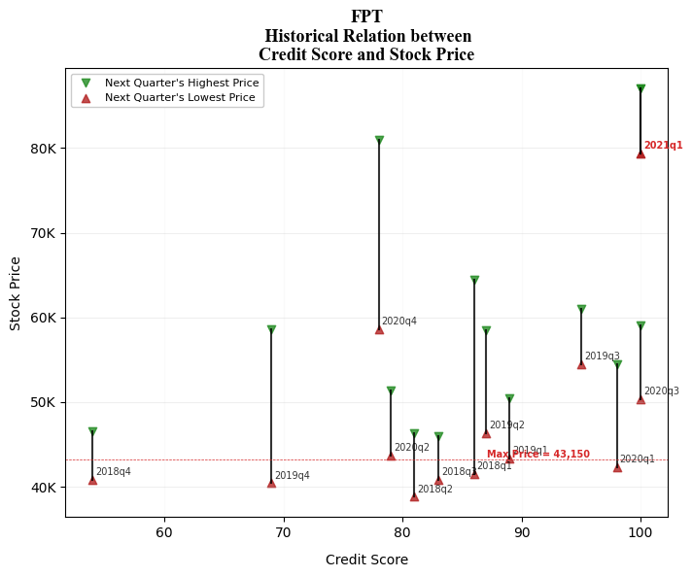
general industries HOSE: FPT - FPT Corporation

Slide 53
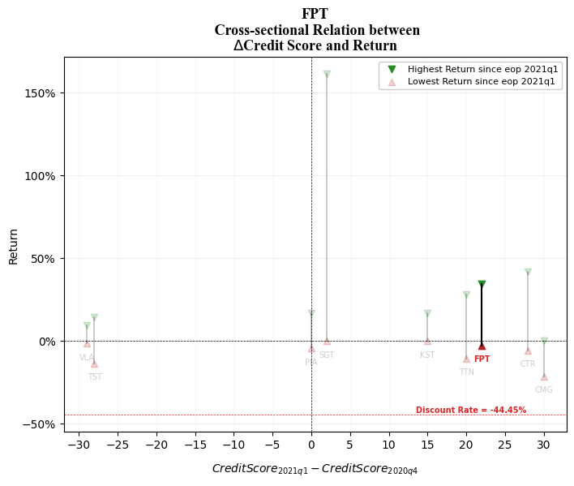
general industries HOSE: FPT - FPT Corporation

Slide 54
HOSE: DGW DIGIWORLD CORPORATION

Slide 55
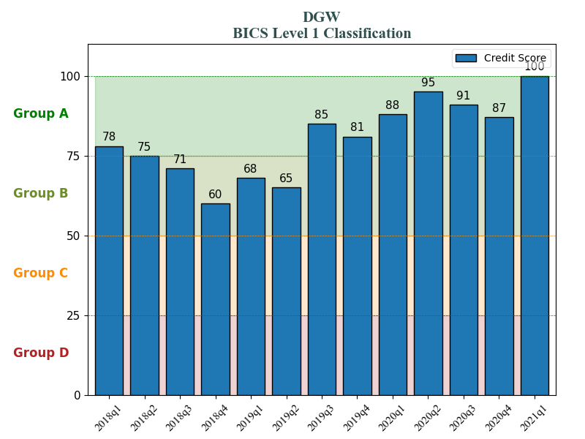
general industries HOSE: MWG - Mobile World Investment Corporation
general industries HOSE: DGW - DIGIWORLD CORPORATION

Slide 56
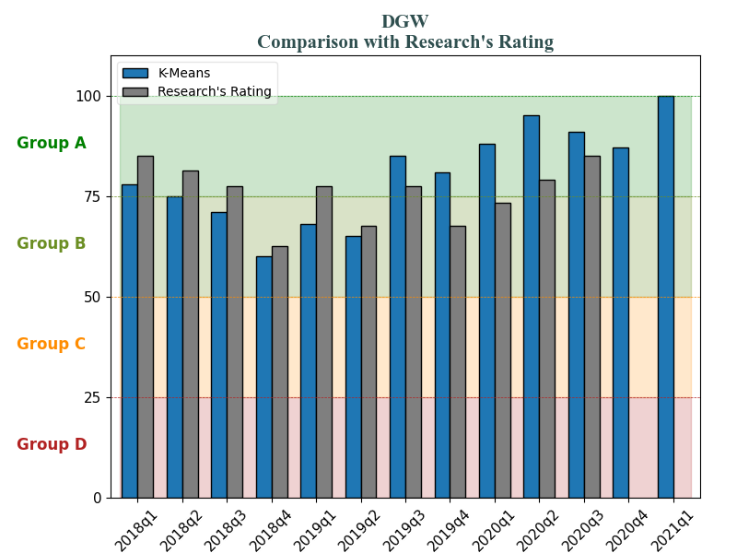
general industries HOSE: MWG - Mobile World Investment Corporation
general industries HOSE: DGW - DIGIWORLD CORPORATION

Slide 57
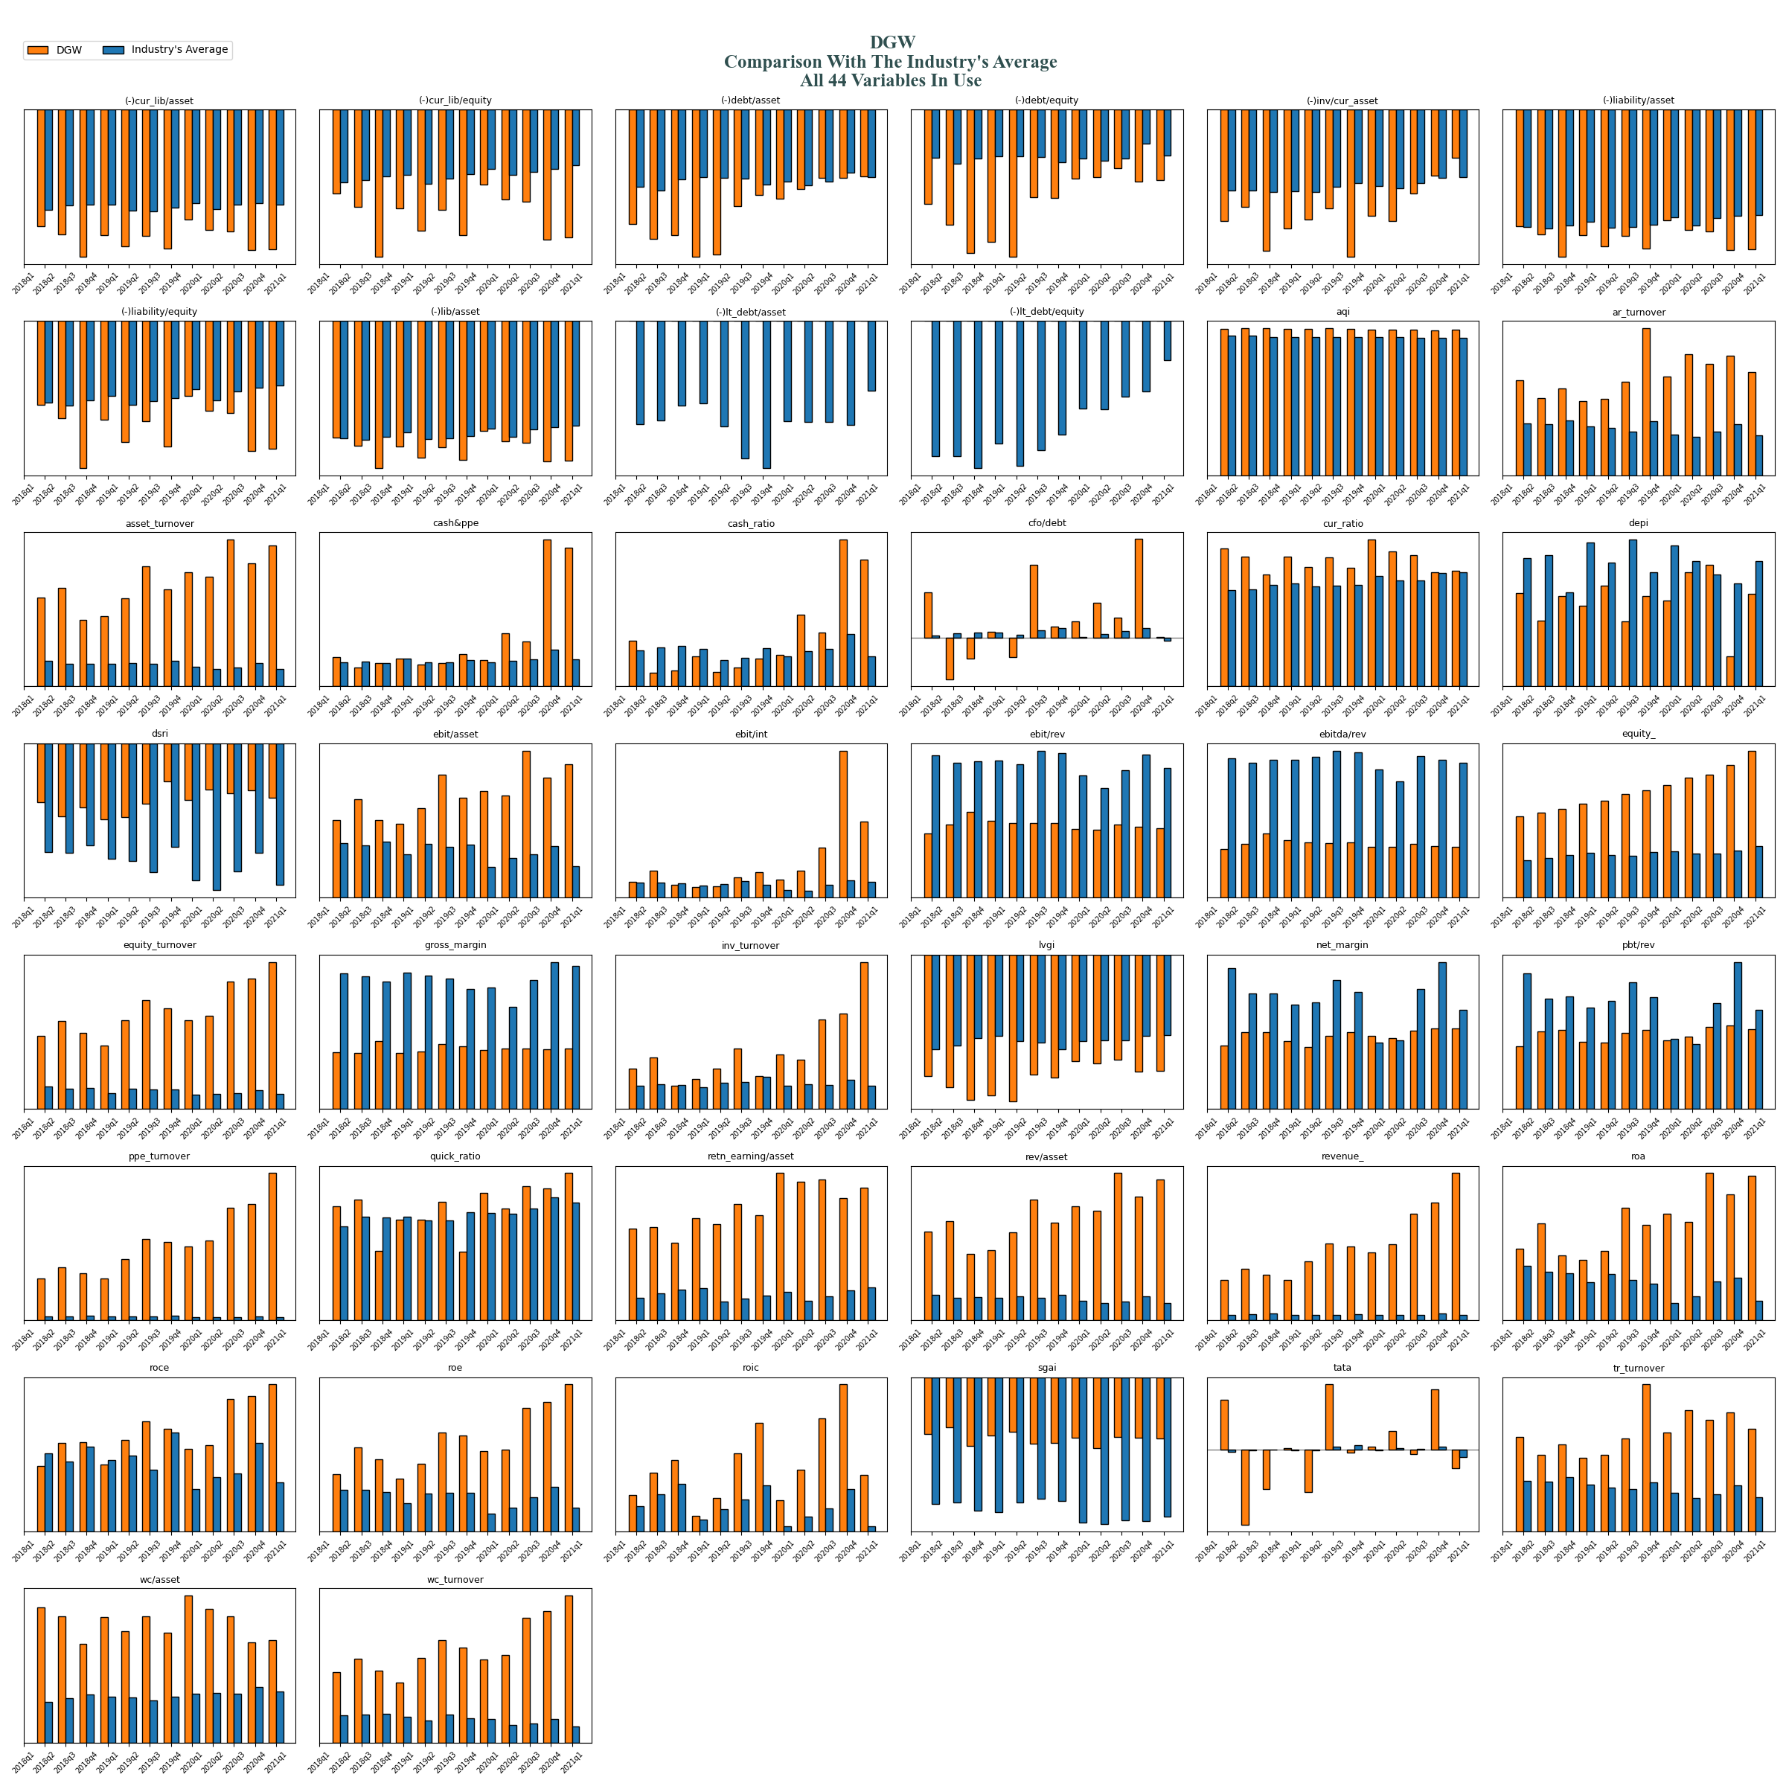
general industries HOSE: DGW - DIGIWORLD CORPORATION

Slide 58
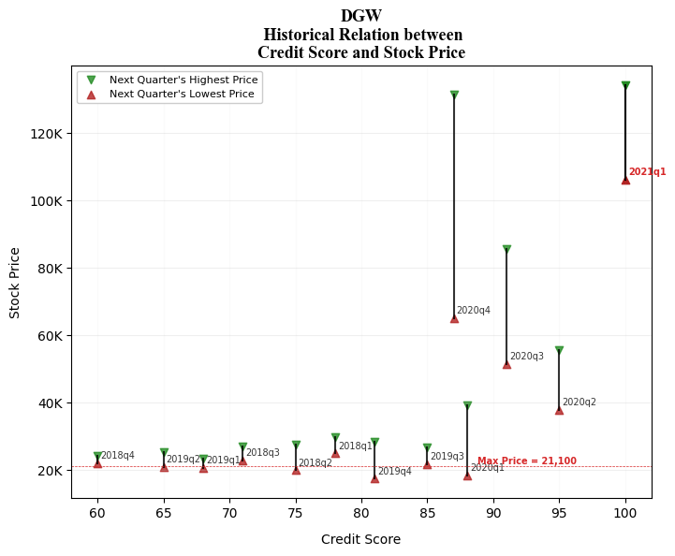
general industries HOSE: DGW - DIGIWORLD CORPORATION

Slide 59
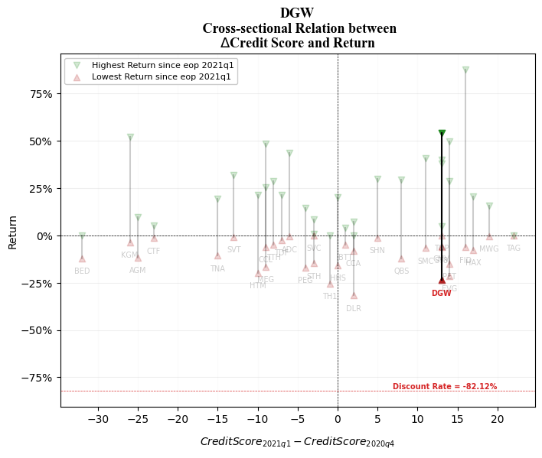
general industries HOSE: DGW - DIGIWORLD CORPORATION

Slide 60
HNX: NTP Tien Phong Plastic Joint Stock Company

Slide 61
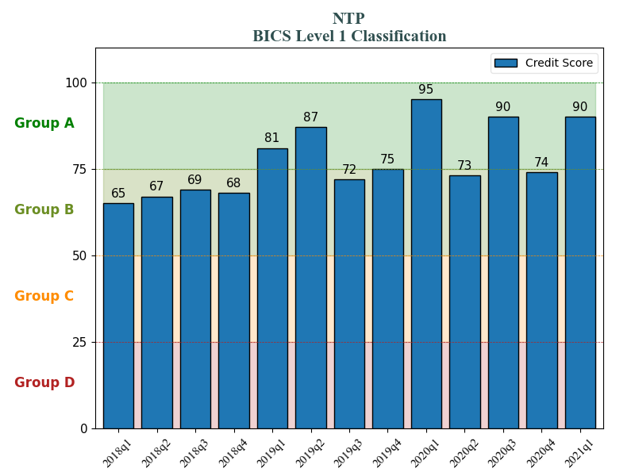
general industries HOSE: MWG - Mobile World Investment Corporation
general industries HOSE: NTP - Tien Phong Plastic Joint Stock Company

Slide 62
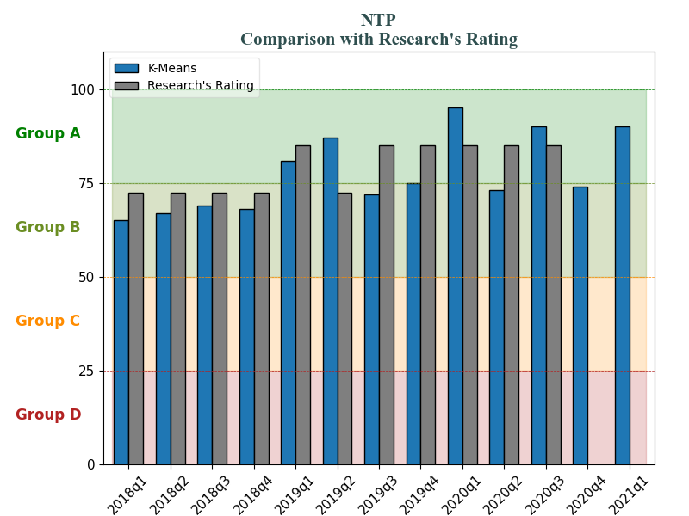
general industries HOSE: MWG - Mobile World Investment Corporation
general industries HOSE: NTP - Tien Phong Plastic Joint Stock Company

Slide 63
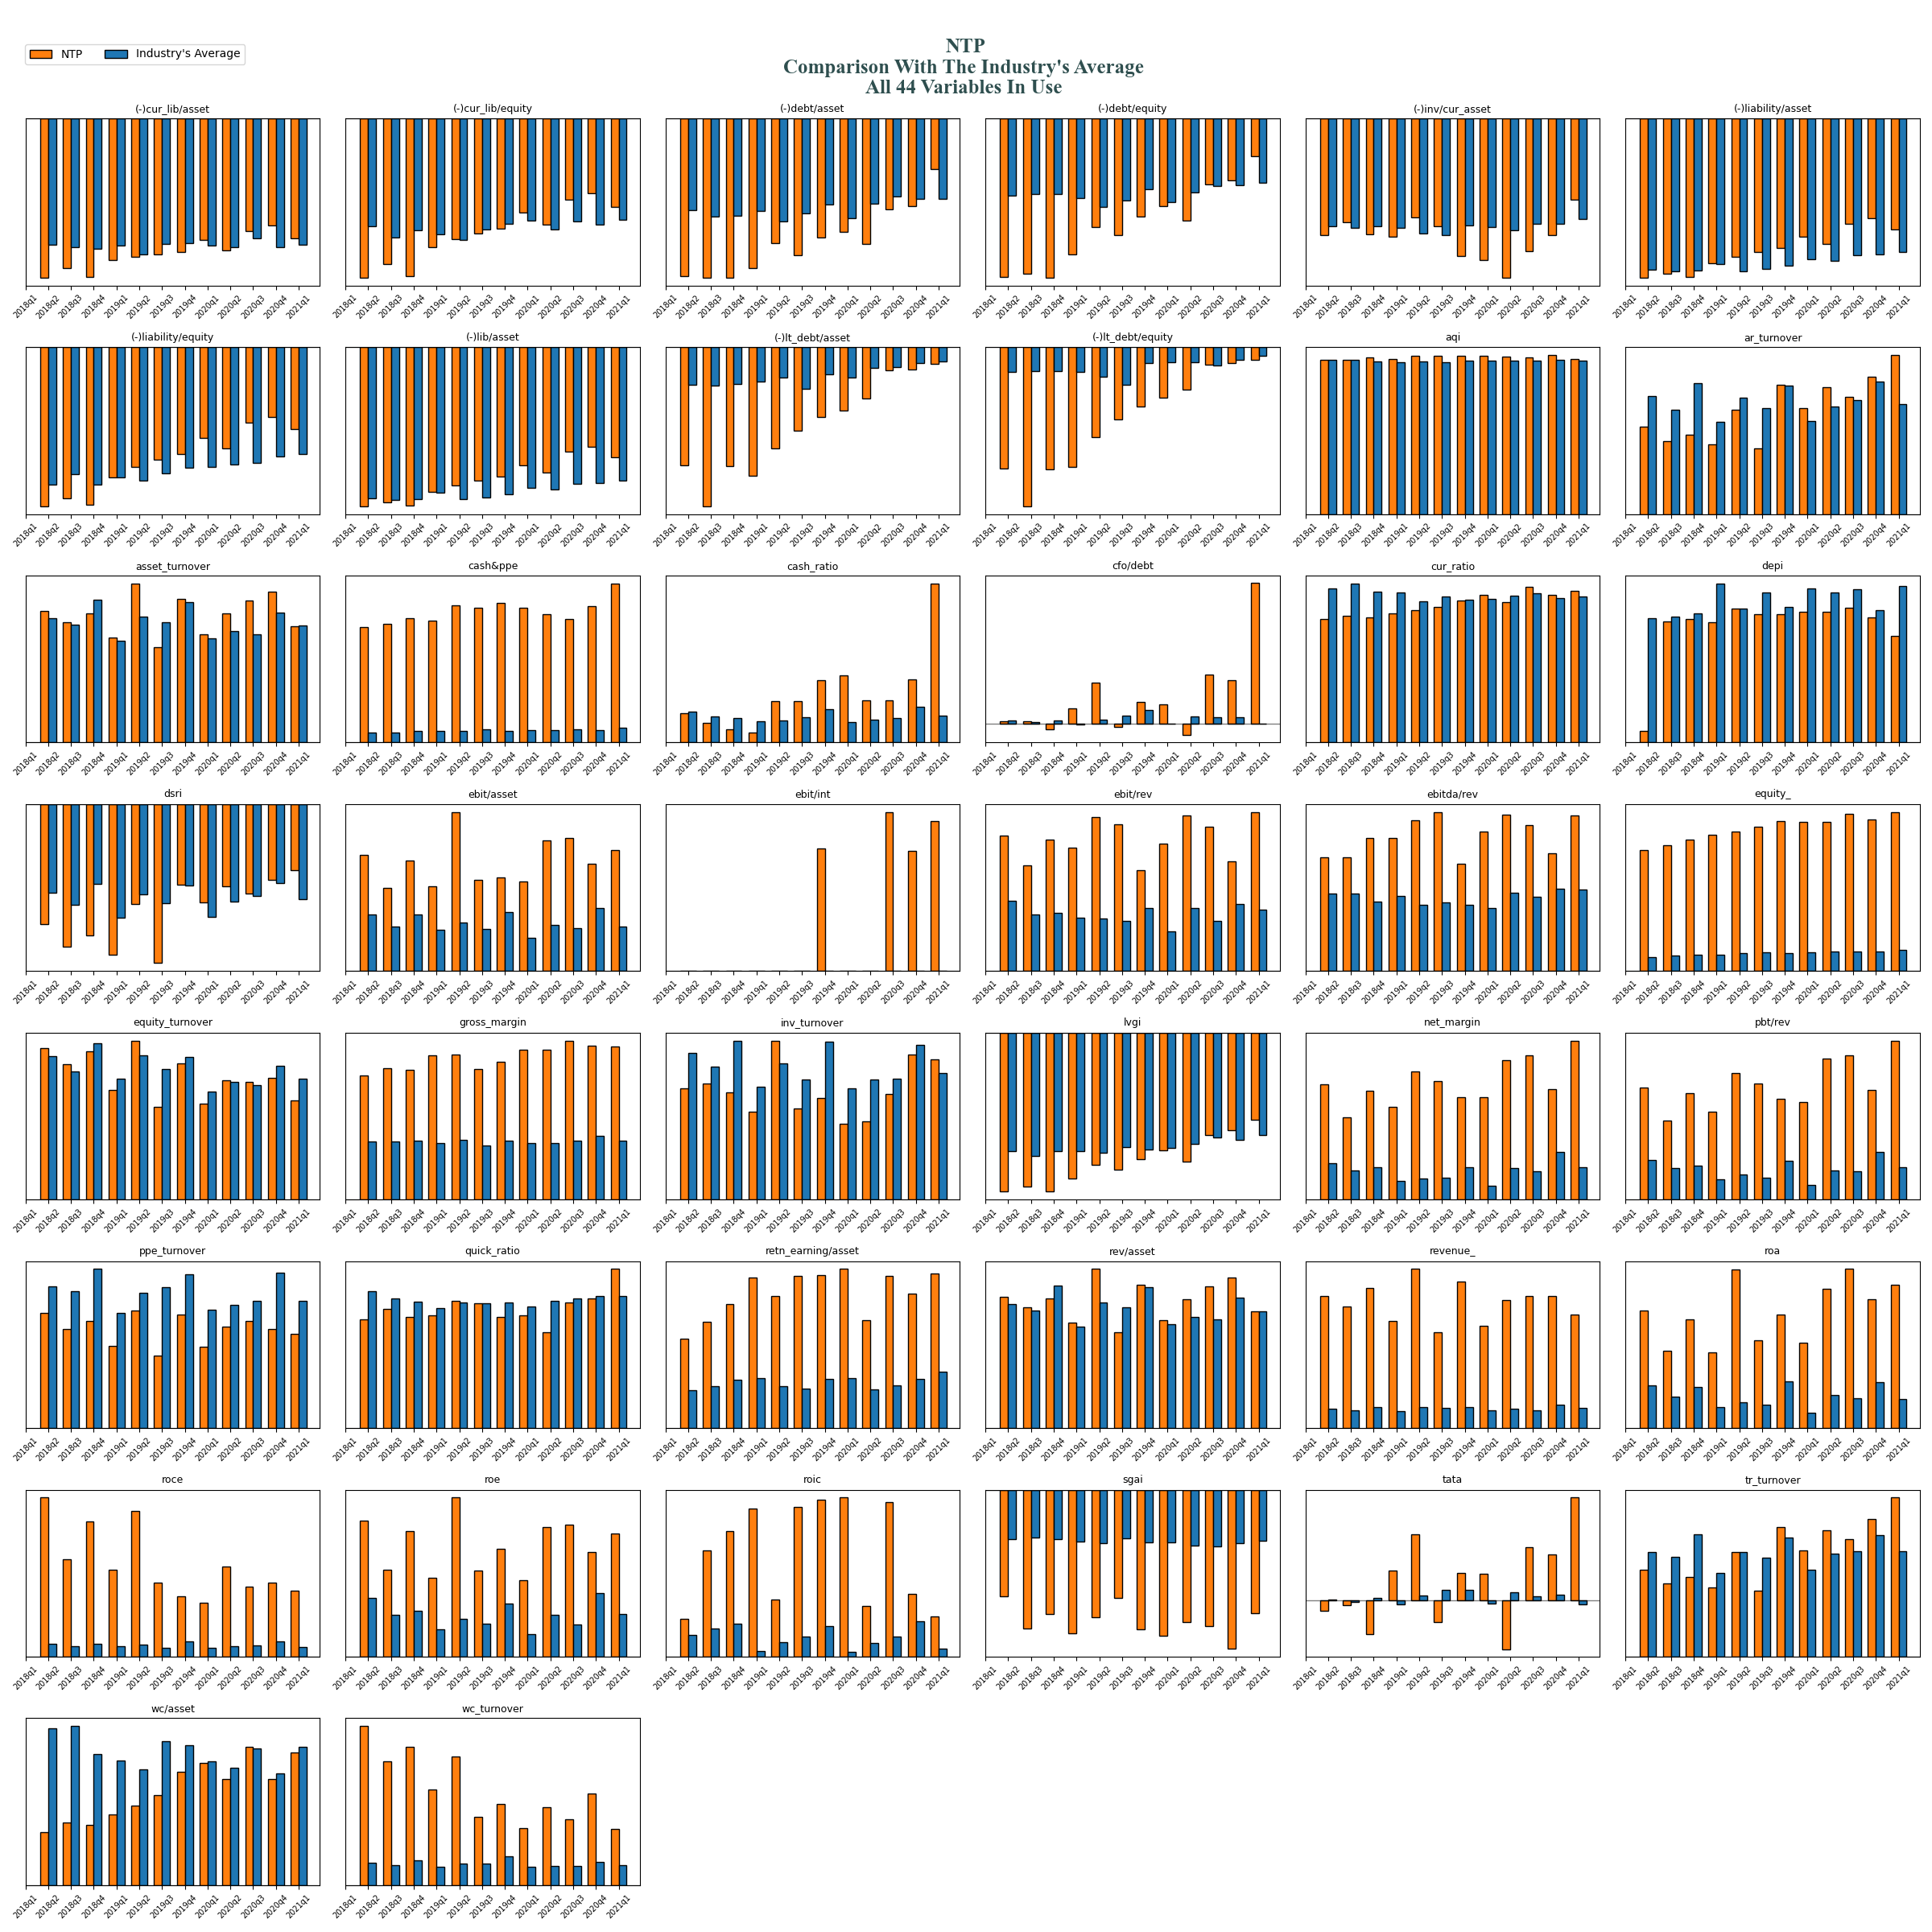
general industries HOSE: NTP - Tien Phong Plastic Joint Stock Company

Slide 64
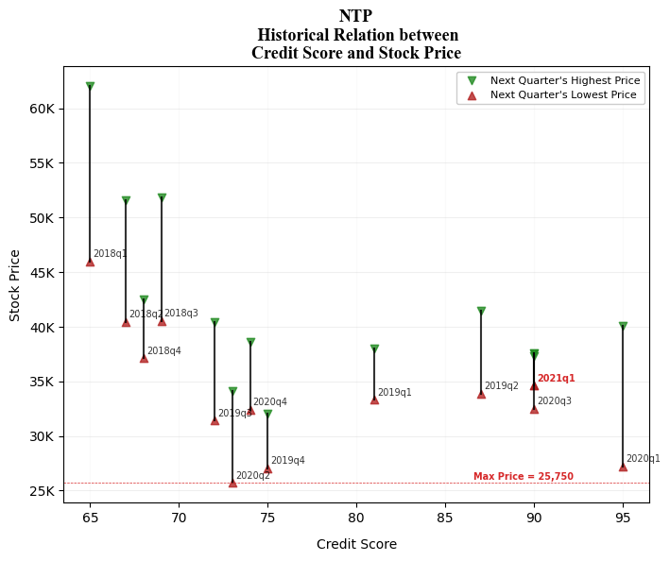
general industries HOSE: NTP - Tien Phong Plastic Joint Stock Company

Slide 65
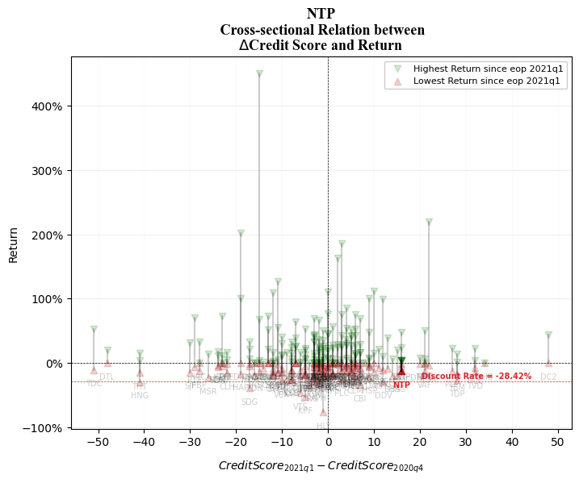
general industries HOSE: NTP - Tien Phong Plastic Joint Stock Company

Slide 66
HOSE: BMP Binh Minh Plastics Joint Stock Company

Slide 67
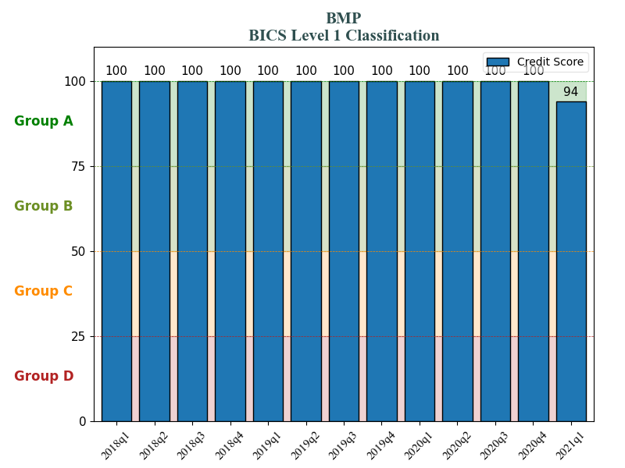
general industries HOSE: MWG - Mobile World Investment Corporation
general industries HOSE: BMP - Binh Minh Plastics Joint Stock Company

Slide 68
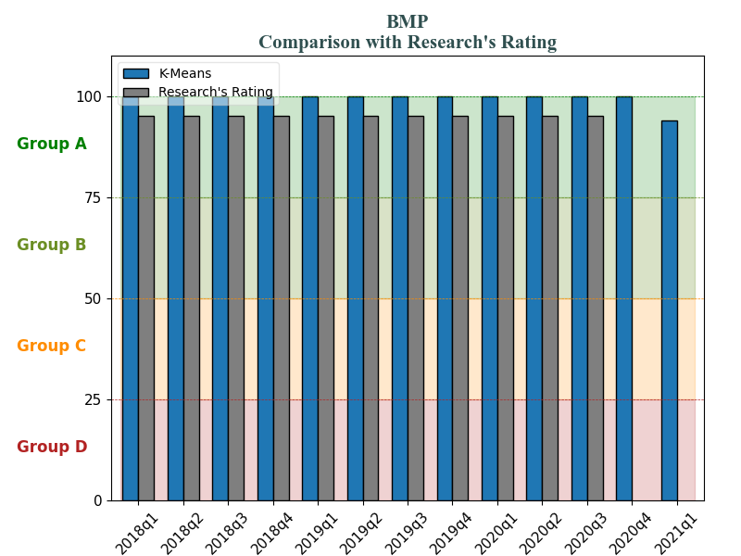
general industries HOSE: MWG - Mobile World Investment Corporation
general industries HOSE: BMP - Binh Minh Plastics Joint Stock Company

Slide 69
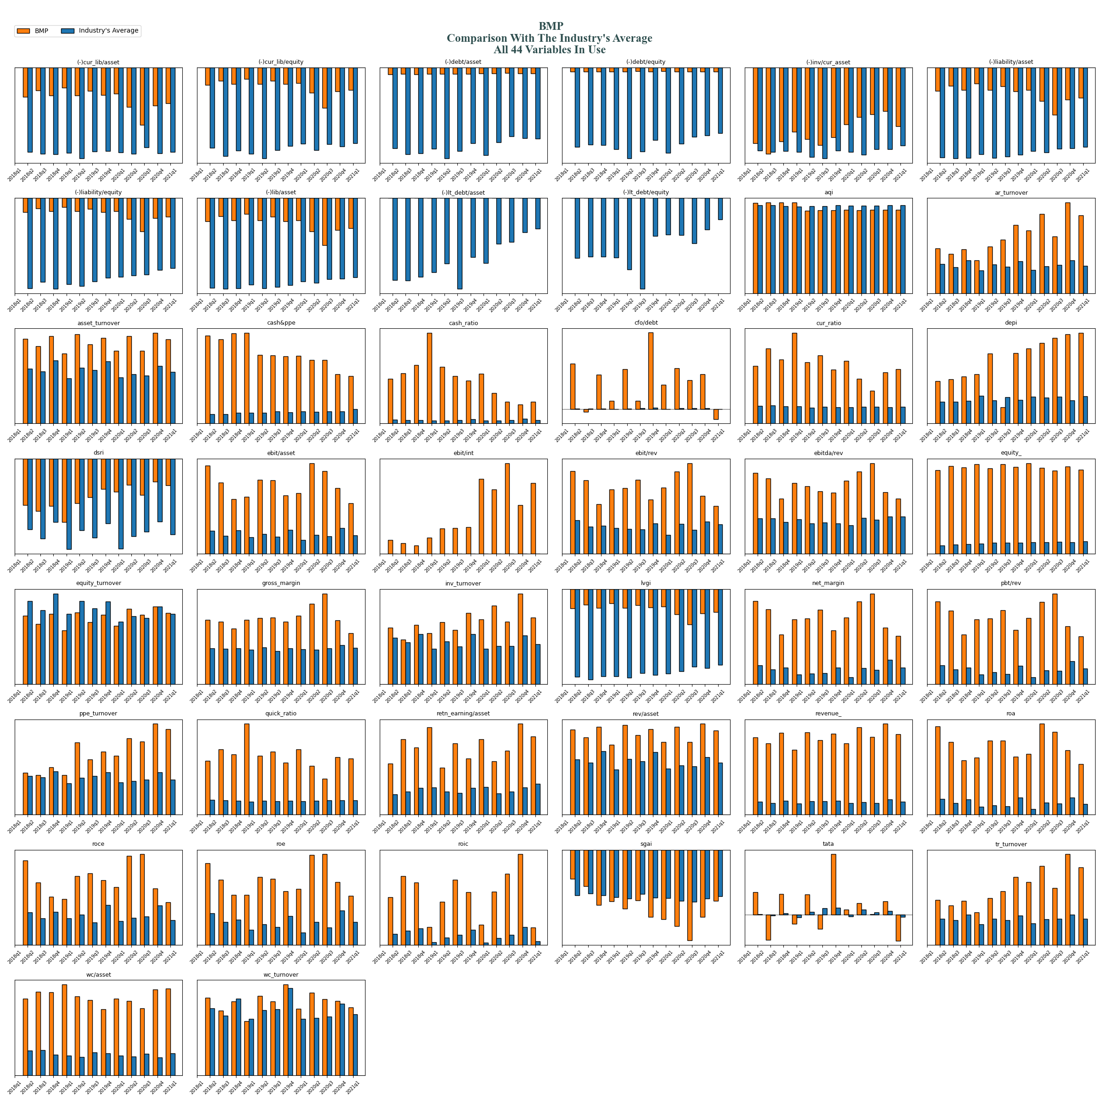
general industries HOSE: BMP - Binh Minh Plastics Joint Stock Company

Slide 70
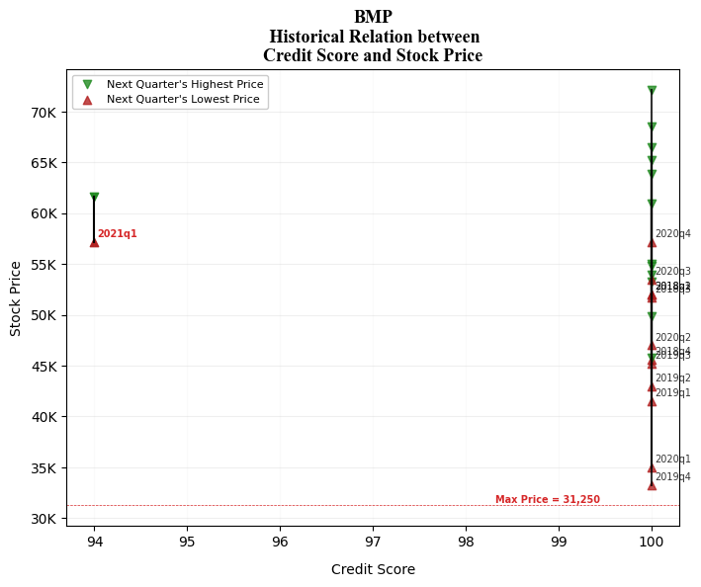
general industries HOSE: BMP - Binh Minh Plastics Joint Stock Company

Slide 71
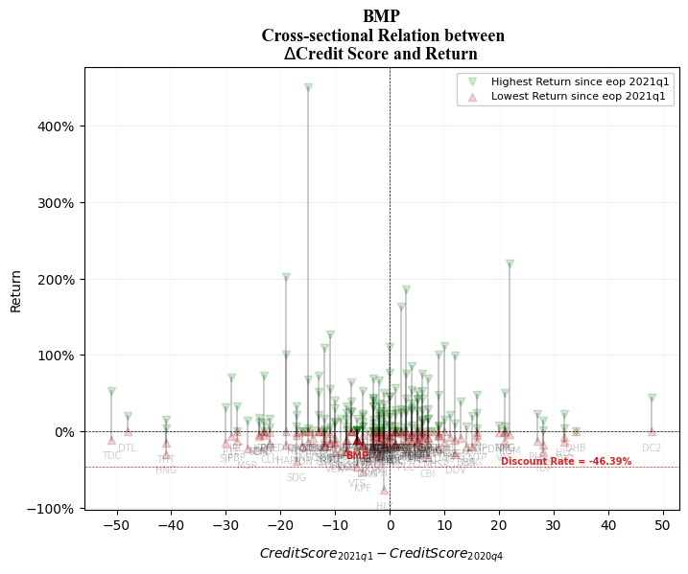
general industries HOSE: BMP - Binh Minh Plastics Joint Stock Company

Slide 72
HOSE: VCB Bank for Foreign Trade of Vietnam

Slide 73
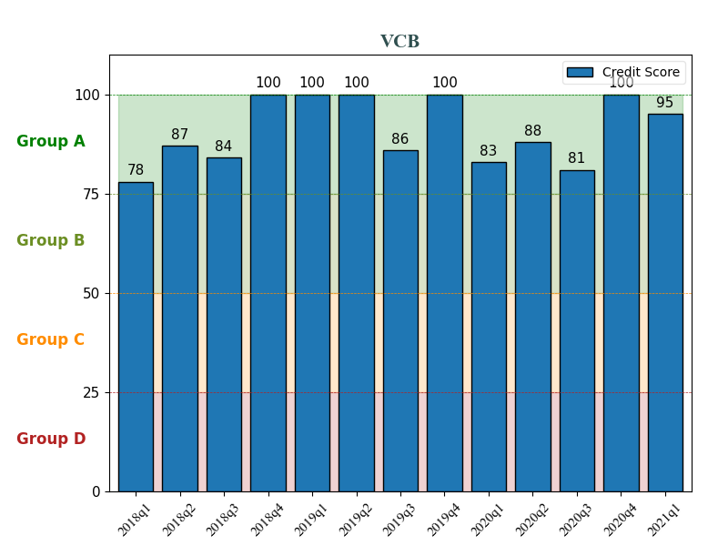
general industries HOSE: MWG - Mobile World Investment Corporation
Banking
industry HOSE: VCB - Bank for Foreign Trade of Vietnam

Slide 74

general industries HOSE: MWG - Mobile World Investment Corporation
Banking
industry HOSE: VCB - Bank for Foreign Trade of Vietnam

Slide 75

Banking
industry HOSE: VCB - Bank for Foreign Trade of Vietnam

Slide 76

Banking
industry HOSE: VCB - Bank for Foreign Trade of Vietnam

Slide 77

Banking
industry HOSE: VCB - Bank for Foreign Trade of Vietnam

Slide 78
HOSE: TCB Vietnam Technological and Commercial Joint Stock Bank

Slide 79

general industries HOSE: MWG - Mobile World Investment Corporation
Banking
industry HOSE: TCB - Vietnam Technological and Commercial Joint Stock Bank

Slide 80

general industries HOSE: MWG - Mobile World Investment Corporation
Banking
industry HOSE: TCB - Vietnam Technological and Commercial Joint Stock Bank

Slide 81

Banking
industry HOSE: TCB - Vietnam Technological and Commercial Joint Stock Bank

Slide 82

Banking
industry HOSE: TCB - Vietnam Technological and Commercial Joint Stock Bank

Slide 83

Banking
industry HOSE: TCB - Vietnam Technological and Commercial Joint Stock Bank

Slide 84
HOSE: BID JSC Bank For Investment And Development Of Vietnam

Slide 85

general industries HOSE: MWG - Mobile World Investment Corporation
Banking
industry HOSE: BID - JSC Bank For Investment And Development Of Vietnam

Slide 86

general industries HOSE: MWG - Mobile World Investment Corporation
Banking
industry HOSE: BID - JSC Bank For Investment And Development Of Vietnam

Slide 87

Banking
industry HOSE: BID - JSC Bank For Investment And Development Of Vietnam

Slide 88

Banking
industry HOSE: BID - JSC Bank For Investment And Development Of Vietnam

Slide 89

Banking
industry HOSE: BID - JSC Bank For Investment And Development Of Vietnam

Slide 90
HOSE: ACB Asia Commercial Bank

Slide 91

general industries HOSE: MWG - Mobile World Investment Corporation
Banking
industry HOSE: ACB - Asia Commercial Bank

Slide 92

general industries HOSE: MWG - Mobile World Investment Corporation
Banking
industry HOSE: ACB - Asia Commercial Bank

Slide 93

Banking
industry HOSE: ACB - Asia Commercial Bank

Slide 94

Banking
industry HOSE: ACB - Asia Commercial Bank

Slide 95

Banking
industry HOSE: ACB - Asia Commercial Bank

Slide 96
HOSE: SSI SSI Securities Corporation

Slide 97

general industries HOSE: MWG - Mobile World Investment Corporation
Brokerage
industry HOSE: ssi - SSI Securities Corporation

Slide 98

general industries HOSE: MWG - Mobile World Investment Corporation
Brokerage
industry HOSE: ssi - SSI Securities Corporation

Slide 99

Brokerage
industry HOSE: ssi - SSI Securities Corporation

Slide 100

Brokerage
industry HOSE: ssi - SSI Securities Corporation

Slide 101

Brokerage
industry HOSE: ssi - SSI Securities Corporation

Slide 102
HOSE: VND VNDirect Securities Corporation

Slide 103

general industries HOSE: MWG - Mobile World Investment Corporation
Brokerage
industry HOSE: VND - SSI Securities Corporation

Slide 104

general industries HOSE: MWG - Mobile World Investment Corporation
Brokerage
industry HOSE: VND - SSI Securities Corporation

Slide 105

Brokerage
industry HOSE: VND - SSI Securities Corporation

Slide 106

Brokerage
industry HOSE: VND - SSI Securities Corporation

Slide 107

Brokerage
industry HOSE: VND - SSI Securities Corporation

Slide 108
HOSE: MBS MB Securities Joint Stock Company

Slide 109

general industries HOSE: MWG - Mobile World Investment Corporation
Brokerage
industry HOSE: MBS - MB Securities Joint Stock Company

Slide 110

general industries HOSE: MWG - Mobile World Investment Corporation
Brokerage
industry HOSE: MBS - MB Securities Joint Stock Company

Slide 111

Brokerage
industry HOSE: MBS - MB Securities Joint Stock Company

Slide 112

Brokerage
industry HOSE: MBS - MB Securities Joint Stock Company

Slide 113

Brokerage
industry HOSE: MBS - MB Securities Joint Stock Company

Slide 114
HNX: PVI PVI Holdings

Slide 115

general industries HOSE: MWG - Mobile World Investment Corporation
Brokerage
industry HNX: PVI - PVI Holdings

Slide 116

general industries HOSE: MWG - Mobile World Investment Corporation
Brokerage
industry HNX: PVI - PVI Holdings

Slide 117

Brokerage
industry HNX: PVI - PVI Holdings

Slide 118

Brokerage
industry HNX: PVI - PVI Holdings

Slide 119

Brokerage
industry HNX: PVI - PVI Holdings

Slide 120
HOSE: BMI Bao Minh Insurance Corporation

Slide 121

general industries HOSE: MWG - Mobile World Investment Corporation
Brokerage
industry HOSE: bmi - Bao Minh Insurance Corporation

Slide 122

general industries HOSE: MWG - Mobile World Investment Corporation
Brokerage
industry HOSE: bmi - Bao Minh Insurance Corporation

Slide 123

Brokerage
industry HOSE: bmi - Bao Minh Insurance Corporation

Slide 124

Brokerage
industry HOSE: bmi - Bao Minh Insurance Corporation

Slide 125

Brokerage
industry HOSE: bmi - Bao Minh Insurance Corporation

Slide 126
stock crash indicator
How well this model alerted dying companies?

Slide 127
HOSE: DAH Dong a hotel group

Slide 128

hnx: DAH - Dong a hotel group
Stock price dropped 75% in 2020q3
Stock price dropped 75%
Stock Price Dropped 75%

Slide 129

hnx: DAH - Dong a hotel group
Stock price dropped down to 4,500 VND
in 2020q3
Stock price dropped 75%

Slide 130
HOSE: TNI THANH NAM GROUP JOINT STOCK COMPANY

Slide 131

HOSE: TNI - THANH NAM GROUP JOINT STOCK COMPANY
Stock price dropped 60% in 2020q2
Stock price dropped 75%
Stock Price Dropped 60%

Slide 132

HOSE: TNI - THANH NAM GROUP JOINT STOCK COMPANY
Stock price dropped down to 4,100 VND
in 2020q2
Stock price dropped 75%

Slide 133
HOSE: TVB tri viet securities joint stock corporation

Slide 134

HOSE: tvb - tri viet securities joint stock corporation
Stock price dropped 27% in 2020q1
Stock price dropped 75%
Stock Price Dropped 27%

Slide 135

HOSE: tvb - tri viet securities joint stock corporation
Stock price dropped down to 12,700 VND
in 2020q1
Stock price dropped 75%

Slide 136
HOSE: DTL dAI THIEN LOC CORPORATION

Slide 137

HOSE: DTL - DAI THIEN LOC CORPORATION
Stock price dropped 75% in 2020q1
Stock price dropped 75%
Stock Price Dropped 75%

Slide 138

HOSE: DTL - DAI THIEN LOC CORPORATION
Stock price dropped down to 8,000 VND
in 2020q1
Stock price dropped 75%

Slide 139
HOSE: LCG LICOGI 16 JOINT STOCK COMPANY

Slide 140

HOSE: LCG - LICOGI 16 JOINT STOCK COMPANY
Stock price dropped 60% in 2020q1
Stock price dropped 75%
Stock Price Dropped 60%

Slide 141

HOSE: LCG - LICOGI 16 JOINT STOCK COMPANY
Stock price dropped down to 3,800 VND
in 2020q1
Stock price dropped 75%

Slide 142
HOSE: LDG LDG INVESTMENT JOINT STOCK COMPANY

Slide 143

HOSE: LDG - LDG INVESTMENT JOINT STOCK COMPANY
Stock price dropped 60% in 2020q1
Stock price dropped 75%
Stock Price Dropped 60%

Slide 144

HOSE: LDG - LDG INVESTMENT JOINT STOCK COMPANY
Stock price dropped down to 3,800 VND
in 2020q1
Stock price dropped 75%

Slide 145
HOSE: LGL Long giang investment & development

Slide 146

HOSE: LGL - Long giang investment & development
Stock price dropped 50% in 2020q1
Stock price dropped 75%
Stock Price Dropped 50%

Slide 147

HOSE: LGL - Long giang investment & development
Stock price dropped down to 3,900 VND
in 2020q1
Stock price dropped 75%

Slide 148
HANDOVER PROPOSAL
HOW WE INCORPORATE OUR RESEARCH FOR FURTHER USAGE?

Slide 149


Stock price dropped 75%
Page 1

Slide 150

Stock price dropped 75%
Page 2

Slide 151
Stock price dropped 75%
Page 3

Slide 152
next step
web scrapping & text mining

Slide 153
target webpages Using BeautifulSoup4, Selenium and REGEX to extract information
https://www.vsd.vn/vi/tin-tuc
For RMD and other Departments to automatically update daily news
https://www.hsx.vn/
https://www.hnx.vn/
https://ndh.vn
https://www.vietstock.vn/
For stock monitor
https://www.cafef.vn/

Slide 154


progress Finished www.vsd.vn www.hsx.vn www.hnx.vn

Slide 155

Thank You
Email: hiepdang@phs.vn
Ext: 8189

